Slide 1
Constraining the properties of dense matter
William Lynch, Michigan State University
What is the EOS? ⇒
1. Relationship to nuclear masses ⇒
2. Theoretical approaches ⇒
3. Example: T=0 with Skyrme ⇒
4. Relevance to astrophysics⇒
B. What nuclear observables are sensitive to the symmetric matter EOS and at what densities?⇒
1. Giant resonances⇒
2. Particle flow and particle production⇒
3. Resulting constraints⇒
C. What nuclear observables are sensitive to the symmetry energy and at what densities? ⇒
1. Binding energies ⇒
2. Radii of neutron and proton matter in nuclei ⇒
3. “Pygmy” and Giant resonances ⇒⇒
4. Particle flow and particle production⇒
D. Summary ⇒
Notes:
I am an expermentalist. Nevertheless, I will begin with theory, but at the level that an experimentalist should understand. Here is my outline. I will begin with a discussion of what is an equation of state and then, hopefully, get to the point of discussing some astophysical applications where haveing one is relevent.

Slide 2
Notes:
We start with some basic thermodynamics

Slide 3
Notes:
Pressure can be obtained from some more easily calculable quantities

Slide 4
Notes:
Nuclear are Fermi liquids. It’s common to estimate nuclear properties using Fermi gas. In this limit the themal properties are relatively straightforward if you know the zero temperature limit.

Slide 5
O
Notes:
In the following, I will be discussing EoS’ for single phase homogeneous matter. Sometimes the densities may actually be close to a phase transition. so it is useful to remember some basics. read it

Slide 6
Nuclear masses and the EoS
B_{A,Z} = a_{v}[1-b₁((N-Z)/A)²]A - a_{s}[1-b₂((N-Z)/A)²]A^{2/3} - a_{c} Z²/A^{1/3} + δ_{A,Z}A^{-1/2} + C_{d}Z²/A,
Fits of the liquid drop binding energy formula experimental masses can provide values for a_{v}, a_{s}, a_{c}, b₁, b₂, C_{d} and δ_{A},_{Z}.
Relationship to EOS
  a_{v} ≈ ε(ρ_{s},0,0); a_{v}b₁≈S(ρ_{s})
  a_{s} and a_{s}b₂ provide information about the density dependence of ε(ρ_{s},0,0) and S(ρ_{s}) at subsaturation densities ρ ≈ 1/2ρ_{s} . (See Danielewicz, Nucl. Phys. A 727 (2003) 233.)
  The various parameters are correlated. Coulomb and symmetry energy terms are strongly correlated. Shell effects make masses differ from LDM.
Mass compilations exist: e.g. Audi et al, NPA 595, (1995) 409.
Measurement techniques:
  Penning traps: ω=qB/m
  Time of flight: TOF=distance/v Bρ=mv/q
  Transfer reactions: A(b,c)D Q=(m_{A}+m_{b}-m_{c}-m_{D})c²
O
Notes:
Now, the EOS has some direct connections to nuclei and their masses. Mainly this concerns the saturatin density and binding energy.

Slide 7
Theoretical approaches for calculating the EoS
Variational and Brueckner model calculations with realistic two-body nucleon-nucleon interactions: (see Akmal et al., PRC 58, 1804 (1998) and refs therein.)
  Variational minimizes <H> with elaborate ground state wavefunction that includes nucleon-nucleon correlations.
  Incorporate three-body interactions (needed for saturation in NR treatments).
    Some are "fundamental"
    Others model relativistic effects.
Relativistic mean field calculations using relativistic effective interactions, (see Lalasissis et al., PRC 55, 540 (1997)
  Well defined transformations under Lorentz boosts (collisions)
  Parameterization can be adjusted to incorporate new data.
Skyrme parameterizations: (Vautherin and Brink, PRC 5, 626 (1972).)
  Requires transformation to local rest frame (collisions)
  Computationally straightforward - example
Notes:
You have already heard about his from experts in Prosf Dobazchivski’s and Meng. So I will just remind you that

Slide 8
T=0 with Shyrme: What is a mean field potential?
Hartree “direct”
Fock “exchange”
Notes:
Prof. Sakai and I talked last week and he reminded me that I should make sure you understand my terminogy, for example, the mean or average field. So I will review briefly something that you have already heard.
Just go thorough it. remind people that the slatter determnant is just all exchanges with (-1)^exchanges

Slide 9
Hartree “direct”
Fock “exchange”
Notes:
excecizer basisally tests dfo you know how to make an antisymetryiv wfn.nAnser is the same for 3 nucleons
Could make time dependend then tdhf

Slide 10
Skyrme effective interactions
Notes:
mention that 3 and higher body terms are necessary for saturation. Certainly so in non-relativisitic theories. There just 2 and 3 body terms make a minimum at saturation density that is two narrow. Need to make it wider.

Slide 11
A simple EOS for asymmetric matter

Slide 12
Hint: use the expressions for the differential increases in potential energy per unit volume above and do a parametric integration over λ from zero to one.

Slide 15
Unlike symmetric matter, the potential energy of neutron matter is expected to be repulsive.
  question: Where is pressure for symmetric matter and neutron matter positive? Where are they negative?

Slide 16
The EoS and Type II supernova: (collapse of 20 solar mass stars)
Supernovae scenario: (Bethe Reference)
  Nuclei H⇒He⇒C⇒...⇒Si⇒Fe
  Fe stable, Fe shell cools and the star collapses
  Matter compresses to ρ>4ρ_{s} and then expands
Relevant densities and matter properties where the EOS plays a role
  Compressed matter inside shock radius ρ₀<ρ<10ρ₀, δ≈0.2–0.9
    What densities are achieved?
    What is the stored energy in the shock?
    What is the neutrino emission from the proto-neutron star?
  Clustered matter outside shock radius – mixed phase of nucleons and nuclear drops - nuclei: ρ<ρ₀, δ≈0.3–0.5
    How much energy is dissipated in vaporizing the drops during the explosion?
    What is the nature of the matter that interacts and traps the neutrinos?
    What are the seed nuclei that are present at the beginning of r-process which makes roughly half of the elements?
Supernova calculations require ε(ρ,T,δ) at all values of ρ, T,δ
O

Slide 17
Summary of last lecture
The EOS describes the macroscopic response of nuclear matter and finite nuclei.
  It can be calculated by various techniques. Skyrme parameterizations are a relatively easy and flexible way to do so. .
  The high density behavior and the behavior at large isospin asymmetries of the EOS are not well constrained.
The behavior at large isospin asymmetries is described by the symmetry energy.
  The symmetry energy has a profound influence on neutron star properties: stellar radii, maximum masses, cooling of proto-neutron stars, phases in the stellar interior, etc.
ε(ρ,0,δ) = ε(ρ,0,0) + δ²⋅S(ρ) ; δ = (ρ_{n}- ρ_{p})/ (ρ_{n}+ ρ_{p}) = (N-Z)/A
O
O

Slide 18
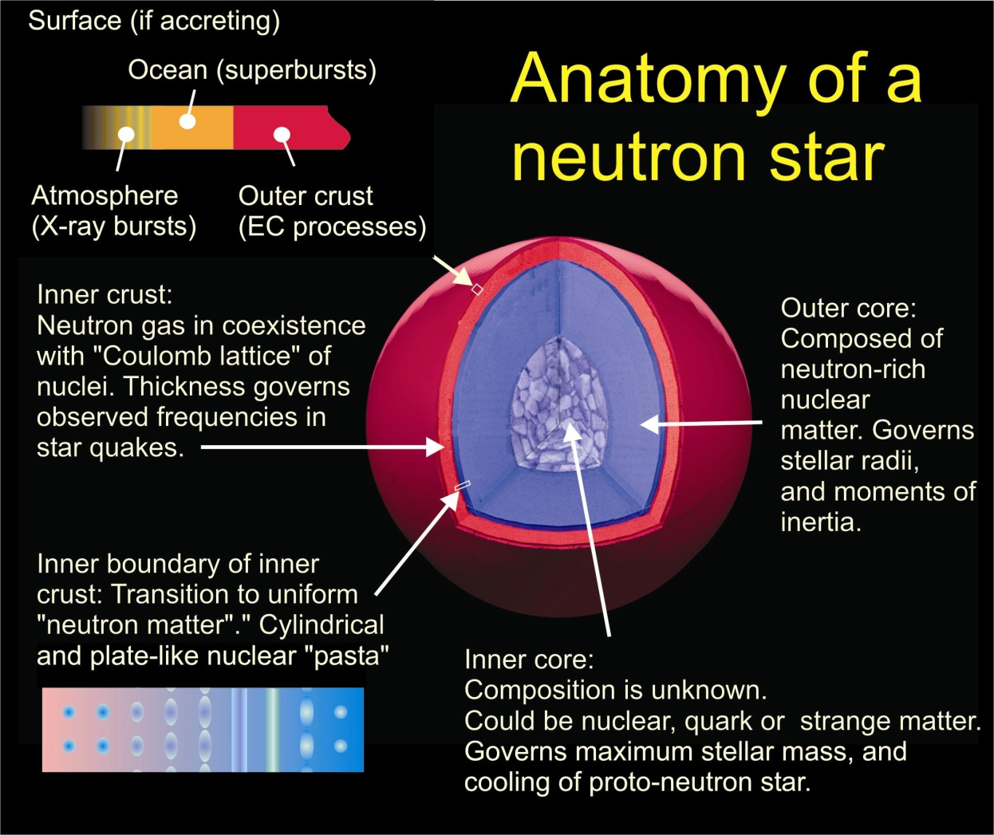
EOS, Symmetry Energy and Neutron Stars
The EOS influences:
Neutron star stability against gravitational collapse
Stellar density profile
Internal structure: occurrence of various phases.
Observational consequences:
  Cooling rates of proto-neutron stars
  Cooling rates for X-ray bursters.
  Stellar masses, radii and moments of inertia.
  Frequencies of crustal vibrations.
Strong motivation for “International X-ray Observatory”
  Cost ~ $2B RY: Possible launch date 2020.
(mainly the symmetry energy)

Slide 19
Sensitivity of the radius to the EoS
Basic Approach:
Neutron star radii :
Radius is obtained by inverting and integrating the Tolman-Oppenheimer-Volkov Equation.
P is the pressure, which depends on the EoS and Symmetry energy.
Need to take electrons and beta-equilibrium into account
2
1.5
Lattimer , Ap. J., 550, 426 (2001).
0.5
0
These equations of state differ only in their density dependent symmetry terms.
Idea is to measure the radii of neutron stars of different masses and constrain the EOS (integral constraint)
Notes:
Now the mass-radus relationship is a statics problem, in which you integrate the stability condition for a mass element to be supported against gravity by the EOS out to the stellar radius. Discussed by Ms. Ngo on Saturday
IF the EOS is stiffer, the matter compresses less and the stellar radius is larger.
In neutron stars, the symmetry energy is especially important. Stiffer symmetry energies lead to larger radii.

Slide 20
Connection between radius and EoS at specific density
The stellar radius is given by an integral involving the EoS over the stellar volume:
  The neutron star radius is only weakly correlated with the symmetry pressure at saturation density.
  There is a stronger correlation between neutron star radii and the pressure at twice saturation density.
  It is important to measure observables that selectively probe specific densities,
Notes:
I want to stress again the limitations of a single neutron star mass-radius measurement to determine the EOS or a single EOS constraint to determine the radius of a star of a given mass.

Slide 21
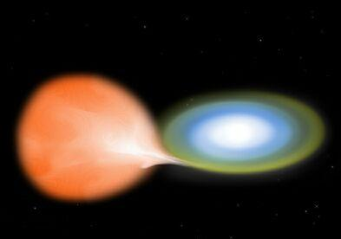
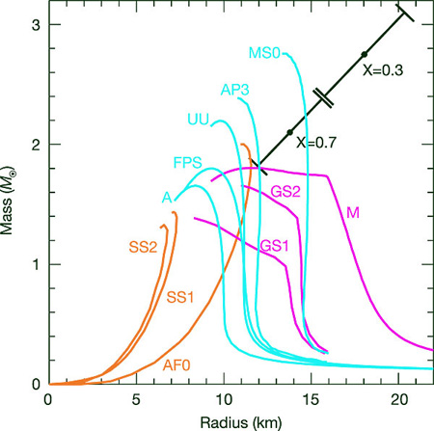
Previous attempt: X-ray bursters
F. Ozel, Nature 441, 1115 (2006).
nucleonic matter
Companion star
neutron star
M/M_{sun}
EXO 0748 – 676 is a neutron star in a Binary system, which emits bursts of X-rays.
Recent X-ray observations with XMM-Newton have identified red-shifted lines of O and Fe.
  red shift ⇒M/R
Other assumptions:
  Eddington flux: F_{edd}(M,D,R)
  F_{cool}/T_{c}^{4:}: function of (R,M,D)
Radius (km)
stellar distance
Rules out most EOS's
  "...If this object is typical, then condensates² and unconfined quarks¹ do not exist in the centres of neutron stars." Feryal Ozel, Nature 441, 1115 (2006).
The X-ray measurements and conclusions have not been confirmed.
Notes:
As I mentioned earlier, x-ray obaervers have been looking at neutron stars to try to measure the mass-radius relattion. Feryal Ozel has been pioneering this.
Meantion ttaht this is an x-ray burster in a binary system.
Hydrogoen and helium are transferred and form and ocean on the neutron star. Hene here is a ruaway explosion, among the brightest objecrts in the universe at the eddington limit. luminsity is given by mass. measure during the burst and afterwards. need R. M., and D. Lucky case it looked like absortion lines were observed. Two conclusions ependeing on the tmosphere of the star, but both indicate a heavy star and a very large radiua, inconsistent with any EOS nuclear physiscist like.
Unfortunately, this observation of lines was question, it wasn’t ozel observation, she is a theoreis, but lack of confirmation discedited this work.

Slide 22
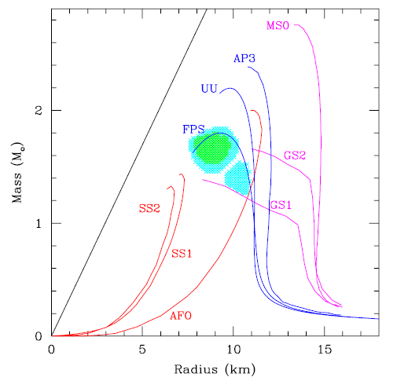
Reanalysis of X-ray bursters data...
F. Ozel, ApJ. 693:1775, (2009).
Companion star
neutron star
Radius (km)
M/M_{sun}
Figure on the right one assumes the thickness of the atmosphere on the star EXO 1745−248 is relatively small: i.e. R _{ps}=R.
  R_{ps}=photosphere radius
  R=neutron star radius
D is known.
Assume Eddington luminosity.
Measure distance plus:
  Eddington flux: F_{edd}(M,D,R)
  F_{cool}/T_{c}^{4:}: function of (R,M,D)
Combine to get M, R
Radius (km)
Shaded region: deduced R,M
Results consistent with a relatively soft equation of state.
Similar, but somewhat more sophisticated analyses can be found in A. Steiner et al, arXiv:1005.0811
Independent constraints from Laboratory measurements would be useful.
O
Notes:
Even though current telescopes cannot probe quiecent x-ray binaries, Some attempts have been made to determine the EOS from x-ray bursters, with mixed success.
here she tried again with another star with known distance. sHTIS TIME, two equqtions- two that were used before, 2 unknowns, different result.

Slide 23
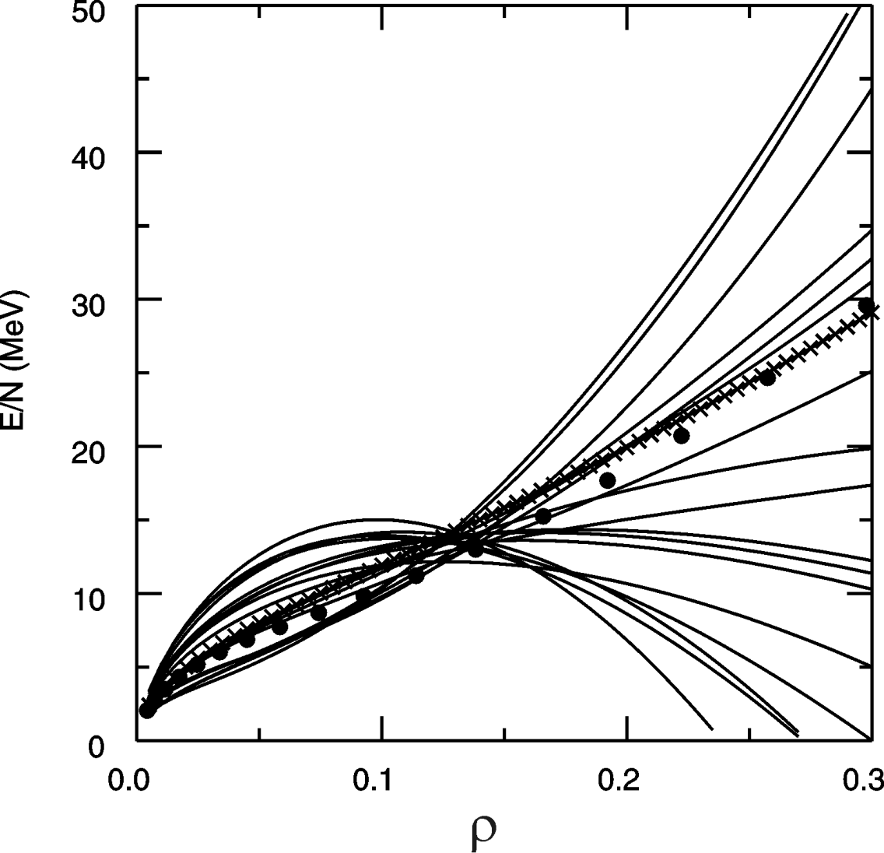
EoS: What are the questions?
B_{A,Z} = a_{v}[1-b₁((N-Z)/A)²]A - a_{s}[1-b₂((N-Z)/A)²]A^{2/3} - a_{c} Z²/A^{1/3} + δ_{A,Z}A^{-1/2} + C_{d}Z²/A,
δ=0
neutron matter
δ=1
ρ₀
Brown, Phys. Rev. Lett. 85, 5296 (2001)
O
E/A (ρ,δ) = E/A (ρ,0) + δ²⋅S(ρ)
δ = (ρ_{n}- ρ_{p})/ (ρ_{n}+ ρ_{p}) = (N-Z)/A
Nuclear effective interactions do not constrain neutron matter,
Main uncertainty is the density dependence of the symmetry energy
Notes:
Today we will be discussing the EOS and in particular its isospin dependence
If we express the EOS as an energy functional, we can isolate the isospin dependence of the EOS by decomposing it into symmetric matter EOS and a symmetry energy term that depends quandratically on the asymmetry.
The symmetric matter EoS describes how the bulk term of the liquid drop mass formulae depends on density.
The symmetry energy describes how the symmetry energy of the liquid drop mass formulae depends on density
The symmetric matter EOS has minimum at saturation density. The curvature about the minimum dictates the monopole resonance energy.
The symmetric matter EOS is a selection of different models for the density dependence..
The Symmetry energy are predictions using 2 and 3 body forces
The symmetry energy does not have a stable minimum that we know of, is increasing at saturation density
Both are uncertain away from saturation density, with the largest uncertainty at high density.
.

Slide 24
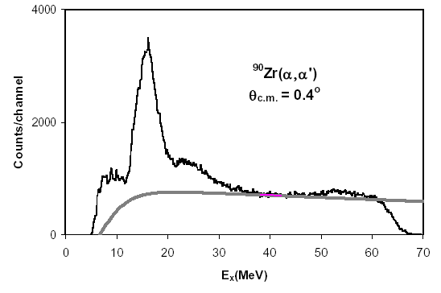
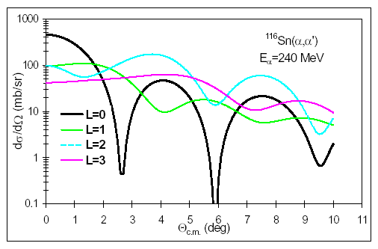
Giant resonances
Imagine a macroscopic, i.e. classical vibration of the matter in the nucleus.
  e.g. Isoscaler Giant Monopole (GMR) resonance
GMR and also ISGDR provide information about the curvature of ε(ρ,0,0) about minimum.
Inelastic α particle scattering e.g. ⁹⁰Zr(α,α′ )⁹⁰Zr* can excite the GMR. (see Youngblood et al., PRL 92, 691 (1999). )
  Peak is strongest at 0°
range of motion
ρ (fm⁻³)
Notes:
first we discuss small vareiations indensity.. Around rho0, the eos is quadratic. In the adiabatic limit the eos can be regarded as a pontential energy, the nucleonic motions are fast compared to the collective vibration. THE MONopole is less that a30 % density variation inmost nuclei. This collective vibration shows up at 17-18 MeV zr and at lower energies in heavier nuclei if you look at 0 degress.

Slide 25
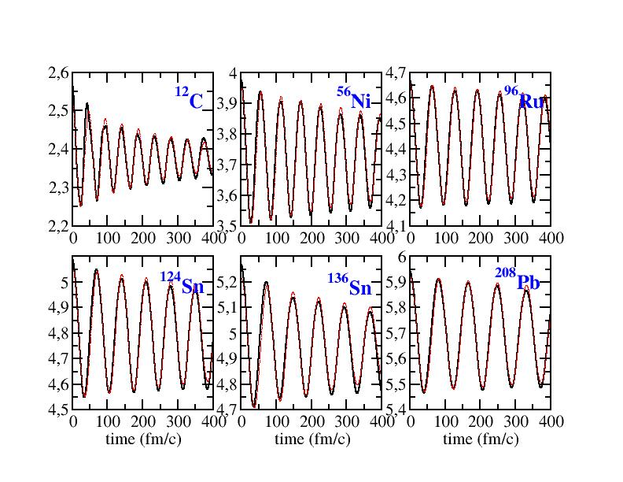
Giant resonances 1
Exercise: Assume that we can approximate a nucleus as having a sharp surface at radius R and ignore the surface, Coulomb and symmetry energy contributions to the nuclear energy.
  In the adiabatic approximation show that
  Show that
  Show that
Vlasov calculations: Gaitanos et al.,
Notes:
you can do a simple calculation to relate the frequency of the monopole to the eos.

Slide 26
Giant resonances 2
Of course, nuclei have surfaces, etc. This motivates a "leptodermous" expansion (see Harakeh and van der Woude, “Giant Resonances” Oxford Science...) :
  K_{sym} is a function of the first and second derivatives of the symmetry energy (G. Colo, et al., Phys. Rev. C70, 024307 (2004).)
  Measurements of GMR resonance energies over a range of isotopes may provide information the first and second derivatives of the symmetry energy as a function of density! (Actually, the first derivative is more important)
Notes:
but a nucleus has a surface and there is the coulomb interaction in the symmetry interaction so the monopole resonance energy is changed by that reflecting that you can do what is called sometimes let the Germans expansion matures contributing to the incompressibility coming from the surface coulomb symmetry the sixth terms probably the most interesting one of symmetry energy term and the Coelho has shown that the symmetry energy term is related to the first and second derivatives of the symmetry energy of the two first produced the most important

Slide 27
Constraints on the symmetric matter EoS from laboratory measurements
The symmetric matter EoS strongly limits what you probe with nuclei
  If the EoS is expanded in a Taylor series about ρ₀, K_{nm} provides the term proportional to (ρ-ρ₀)². GMR analyses indicate K_{nm}=240±10 MeV. Higher order terms influence the EoS at sub-saturation and supra-saturation densities.
  The solid black, dashed brown and dashed blue EoS’s all have K_{nm}=300 MeV → differences between these EoS‘s reflect these higher order terms.
Nuclear properties are mainly sensitive to the EoS at 0.5ρ₀≤ ρ≤1/25ρ₀
To probe the EoS at 3ρ₀, you need to compress matter to 3ρ₀.
Notes:
so the mob will give resonance tells us what’s happening around the minimum if you to tailor expansion higher densities their higher order terms and to constrain those you have to provoke ire against the otherwise you don’t know whether or not their other minima at higher densities may reflect face transitions to different the text material like quark matter

Slide 28
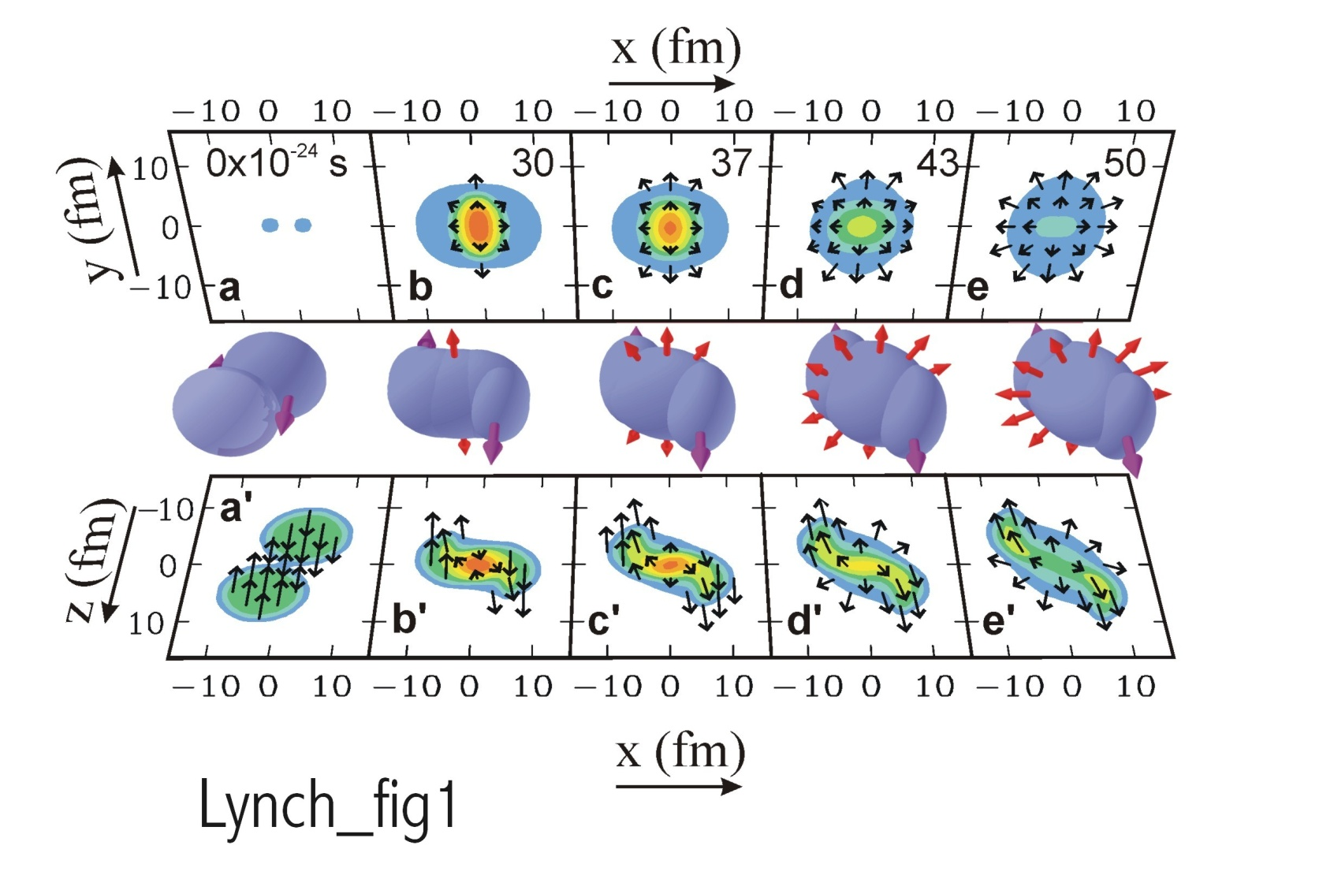
Constraining the EOS at high densities by laboratory collisions
Au+Au collisions E/A = 1 GeV)
pressure contours
density contours
Two observable consequences of the high pressures that are formed:
  Nucleons deflected sideways in the reaction plane.
  Nucleons are “squeezed out” above and below the reaction plane. .
Notes:
set in experiments aimed probing the dense matter the way they work if you take two nuclei of very high energy and collide them together the matter in between is compressed to high density by the matter at this squeezing it from behind front and business calculation illustrating that so the surfaces sorry about 5% saturation density that pack but are shown as several different stages of the collision in time times given ear infirmary to see so the upper panel is the pressure in a plane cut through the perfect of the beam axis and the bottom is the density achieved in the reaction plane perpendicular to the coupling momentum but you see is that at a rather early-stage very high densities achieved coursing their high pressures and then this high-density and pressure causes the system to accelerated away from the system the final moment the observables one uses to extract

Slide 29
Flow studies of the symmetric matter EOS
Theoretical tool: transport theory:
  Example Boltzmann-Uehling-Uhlenbeck eq. (Bertsch Phys. Rep. 160, 189 (1988).) has derivation from Time Dependent Hartree Fock (TDHF):
    f is the Wigner transform of the one-body density matrix
    semi-classically, = (number of nucleons/d³rd³p at ).
    BUU can describe nucleon flows, the nucleation of weakly bound light particles and the production of nucleon resonances.
  The production of heavier fragments is a difficult problem. It have been calculated with Anti-Symmetrized Molecular Dynamics (AMD) and other molecular dynamics techniques with mixed success. Such observables are sensitive to fluctuations in the mean field that give rise to spinodal decomposition.
  The most accurately predicted observables are those that can be calculated from i.e. flows and other average properties of the events.
Notes:
so in order to create a barometer from this one has to do calculations using transport theory are the best-known transferred. This energy domain if she Bolzmann-Uehling-Uhlenbeck equation BUU contrived THF in the classical limit I give you the glass of term/& right-sided seclusion term deficit bigger transform wishes he distribution phase space and particles just read it

Slide 30
Some technical points
Semi-classical: “time dependent Thomas-Fermi theory”
  Respect of Pauli principle is assured by Liouville's theorem and by the blocking factors in the collision integral.
Each nucleon is represented by ~1000 test particles/nucleon that propagate classically under the influence of the self-consistent mean field U and subject to collisions due to the residual interaction.
  QMD basically does the same thing with one test particle/nucleon
Mean field is momentum dependent:
  Momentum dependence of N-N interaction
  Fock term
  Exercise: show that first order term in expansion (in p²) of momentum dependent mean field potential can be combined with p²/(2m) to give p²/(2m_{eff}) , which defines the “effective mass”.
Nucleon-nucleon cross sections are modified in the medium
Notes:
at some points the like to mention this region

Slide 31
Procedure to study EOS using transport theory
Measure collisions
Simulate collisions with BUU or other transport theory
Identify observables that are sensitive to EOS (see Danielewicz et al., Science 298,1592 (2002). for flow observables)
  Directed transverse flow (in-plane)
  “Elliptical flow” out of plane, e.g. “squeeze-out”
  Kaon production. (Schmah, PRC C 71, 064907 (2005))
  Isospin diffusion
  Neutron vs. proton emission and flow.
  Pion production.
Find the mean field(s) that describes the data. If more than one mean field describes the data, resolve the ambiguity with additional data.
Constrain the effective masses and in-medium cross sections by additional data.
Use the mean field potentials to calculate the EOS.
symmetric matter EOS
symmetry energy
quick
detailed
Notes:
now with this transport theory and the data you can place constraints on the symmetry energy in the works the following way this region

Slide 32
Constraining the EOS at high densities by laboratory collisions
Au+Au collisions E/A = 1 GeV)
pressure contours
density contours
quick
Two observable consequences of the high pressures that are formed:
  Nucleons deflected sideways in the reaction plane.
  Nucleons are “squeezed out” above and below the reaction plane. .
Notes:
You’ve seen this before.. I would like to draw your attential to the arrow, which are the momenta of nucleons/
There is a preference of high velocity particles to be emitted perpendicular to the reaction plane early stages. Ms. azimuthally symmetry in the outgoing glossies is called optical flowAnd there is a preferential its operation in the reaction plane left and right. this for F. the symmetry in the transverse momentum skull transfer slow

Slide 33
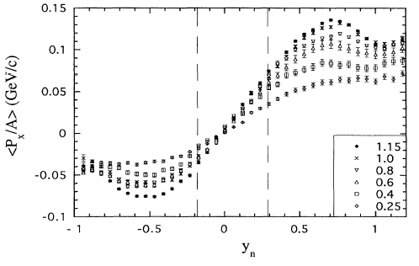
Directed transverse flow
Partlan, PRL 75, 2100 (1995).
target
Au+Au collisions
EOS TPC data
E_{beam}/A (GeV)
projectile
Event has “elliptical” shape in momentum space, with the long axis in the reaction plane ⊥
Analysis procedure:
  Select impact parameter.
  Find the reaction plane.
  Determine <p_{x}(y)> in this plane
  note:
y/y_{beam} (in C.M)
The data display the “s” shape characteristic of directed transverse flow.
  Should be symmetric but the TPC has inefficiencies at y/y_{beam}< -0.2.
  Slope is determined at –0.2<y/y_{beam}<0.3
Notes:
Kessel cartoon about transverse flow showing how you extract it. So for going particles are preferentially in this picture going in the entrance restrictions up at articles like back in the center of mass are preferentially going down plot the momentum to function of the rapidity. Yet the SHA pattern and the slope at midrapidity which the center of mass is a quantity called the flow something like attention to me scattering angle.

Slide 34
Determination of symmetric matter EOS from nucleus-nucleus collisions
Danielewicz et al., Science 298,1592 (2002).
  in plane
  out of plane
O
The curves labeled by K_{nm} represent calculations with parameterized Skyrme mean fields
  They are adjusted to find the pressure that replicates the observed transverse flow.
The boundaries represent the range of pressures obtained for the mean fields that reproduce the data.
They also reflect the uncertainties from the effective masses and in-medium cross sections.
Notes:
she thought this quantities at each incident energy each incident energy Pro for different density. The transverse flow as the peak at about two cheaper nucleon even calculated with different mean fields and see which mean field describes the observations some mean fields are to strongly density dependent giving too much flow others are two-week the defendant density for giving too little fall. You don’t try to make one of these curves at all energies because the shape of the curve depends on the folks LeFort of equation of state with density that you could have all but just try to find that each energy each density what is the equation of state describes the data from the introduced the pressure he do the same thing for elliptical flow then you combining altogether and just focusing on the mean field and look at zero temperature and plot but the pressure is corresponding to the mean field to describe the data as a function of the dense. You can plot theoretical calculations and use the sum equation states are having to high pressures and sum total

Slide 35
Constraints from collective flow on EOS at ρ>2 ρ₀.
E/A (ρ, δ) = E/A (ρ,0) + δ²⋅S(ρ) δ = (ρ_{n}- ρ_{p})/ (ρ_{n}+ ρ_{p}) = (N-Z)/A≈1
Danielewicz et al.,
Science 298,1592 (2002).
Danielewicz et al.,
Science 298,1592 (2002).
O
Note: analysis required additional constraints on m* and σ_{NN}.
Flow confirms the softening of the EOS at high density.
Constraints from kaon production are consistent with the flow constraints and bridge gap to GMR constraints.
The symmetry energy dominates the uncertainty in the n-matter EOS.
Both laboratory and astronomical constraints on the density dependence of the symmetry energy are urgently needed.
Notes:
then you can compare to other observables. You see the bottle resonance lies above the curve but she knew it had to be softened you can compare to theory you see that you will somehow host the goal then you can look at other observables like can production and you can see that it provides a similar constraint the book is somewhat lower densities. Taking it to the neutron star of course you have had the symmetry energy which you don’t didn’t this point have any constraints. So you take two estimationson steeply density dependent oneand weakly density than one. These estimates came from prop – as representative of the theoretical uncertainties and you can see the symmetry energy contributes to bigger uncertainty to the pressure in neutron or then do the remaining uncertainties in the symmetric matter equation is

Slide 36
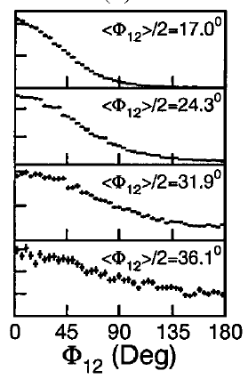
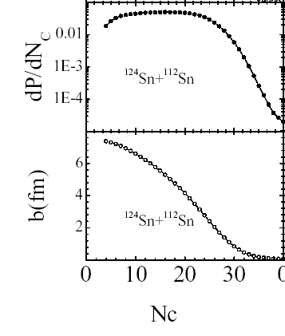
Impact parameter and reaction plane determination
Muliplicity decreases monotonically with impact parameter. Can invert the multiplicity to get b/b_{max}.
Can get b_{max} by measuring the cross section
R
O
The reaction plane contains Q and the beam.
The reaction plane dispersion can be obtained by breaking the event into two sub-events and comparing them.
Notes:
getting impact parameter while generally if a nuke to the data miss each other than the emitted particles and at these energies is very head-on collision system completely breaks up into its constituent nucleons if there is a collision in mid-impact parameters than some of the projectile some of the target escape from being exploded so the number of charge particles produced is lower. So the number of charge particles decreases monotonically with impact parameter and knowing that you can just take the number of charged particles and mathematically in uses monotonic dependence to get a good estimate of the impact parameter of course at any given impact parameter and this is what you to mathematically of course

Slide 37
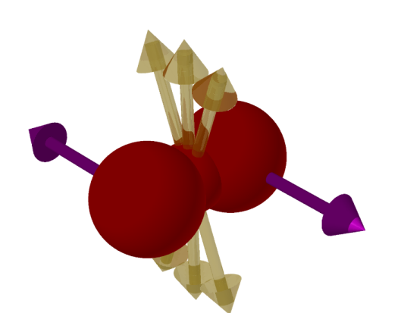
Theoretical problem: constraining the momentum dependence
Momentum dependence, e.g. from vector meson exchange or from the Foch term, reduces the effective mass, increasing the acceleration and making the mean field potential appear “stiffer”.
Ancillary measurements are needed to constrain the momentum dependence
  Out-of-plane enhancement in peripheral collisions.
  Measurements of transverse flow in asymmetric systems.
Danielewicz, Nucl. Phys. A 673, 375.
O
R
Notes:
now when there is a bit effective mass that is less than the nucleon mass, it makes for nucleons essentially accelerate more. This is basically what you’d expect his unit stiffer equation of state. The distinguished the two effects on coming from the effective mass unit coming from the pressure due to high density, one looks at the elliptical flow in collisions were high densities are not achieved so this is completely coming from the acceleration. Then one can ask would effective mass best describes the observed data and that’s other constraints nucleon effective masses about point 7000 of them as

Slide 38
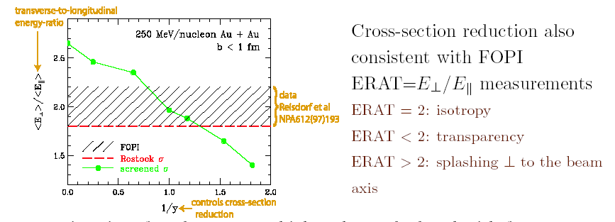
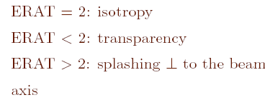
Theoretical problem: constraining σ_{NN}
The in-medium cross sections also increase pressure and thus can introduce ambiguities.
The main effect of cross section is to increase the viscosity of nuclear matter – cross sections that yield the same viscosity, predict the same effects. Selected form:
R
O
Initial:

Slide 39
Determining the EOS from binding energies
Mass compilations exist and fitting is straightforward, but there are problems.
  The Coulomb, volume symmetry and surface symmetry energy terms are strongly correlated.
  Shell and deformation effects are large.
  The binding energy formula is not unique. More than one expressions exist that can give roughly equivalent fits, but lead to different conclusions about the surface symmetry energy. For example, authors have taken the following expressions for the symmetry energy:
  The third expression may be the most reasonable. See Danielewicz, Nucl. Phys. A 727 (2003) 233
The best fits may not even give the most reasonable parameters:
  Care is needed.
OR
OR
O
Notes:
one way to probe this symmetry energy at low densities is to look in the nuclear surface as I discussed earlier there is this a symmetry component to the surface energy. There more than one way to implement this in a mass formula the one I prefer because it is derived i.e. equating the chemical potential in the dense and the Central division central region and absolute surface. However it doesn’t give you the expression you expect insistence thatcare is needed because the interplay between the coulomb and symmetry

Slide 40
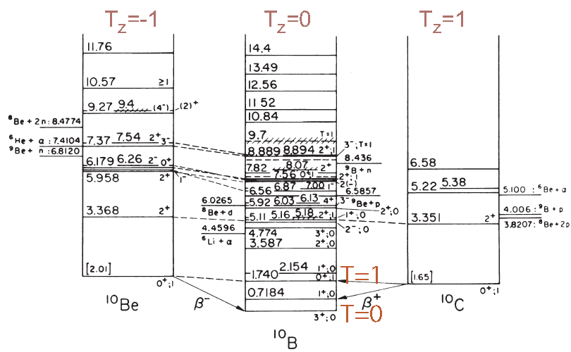
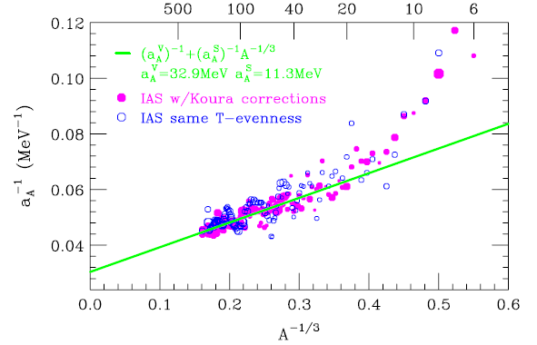
Minimizing uncertainties using analog states
Coulomb energy shifts can be removed by comparing states with different T in the same nucleus (T_{z}=(N-Z)/2)
Can be inverted to obtain a_{sym,A}
Hartree-Fock calculations can be used to relate a_{sym,S} to the density dependence of the symmetry energy at subsaturation (~ρ/2) density.
  The resulting constraints will be shown later
redefining the symmetry energy
Danielewicz (2006)
Notes:
Danielewicz and play an extra click just like to point out using isospin symmetry you realize that you can extract the symmetry energy by just comparing the energy of ground state’s analog states than the coulomb doesn’t matter. Of course isospin symmetry says this energy component is proportional to the square of the isospin not just the Z. component cf. reformulate a little your symmetry energy. But small correction mainly important for any posting nuclei and it basically takes care of the figures are large extent if you then applied nuclear symmetry energy which has both surface and volume components as a function of mass you can isolate the volume of the symmetry in surface symmetry energy components that was done here this figure laterin our final lecture I’ll show you what that means in terms of this of the symmetry energy term of the equation of state

Slide 41
Summary of last lecture
  The symmetry energy has a profound influence on neutron star properties: stellar radii, maximum masses, cooling of proto-neutron stars, phases in the stellar interior, etc.
The high density behavior of the symmetric matter EoS has some initial constraints from the GMR energy, from collective flow and from Kaon production.
  The pressures achieved in high energy collisions are of the order of 10³⁵ N/m²!
The behavior at large isospin asymmetries of the EOS is not well constrained.
The behavior at large isospin asymmetries is described by the symmetry energy.
  Nuclear masses can provide information about the symmetry energy
O
O

Slide 42
Another observable: comparisons of <r²>_{n}^{1/2} and <r²>_{p}^{1/2}
²⁰⁸Pb
softer
stiffer
Approximating the density profile by a Fermi function ρ(r)=ρ₀/(1+exp(r-R)/a), we show representative proton and neutron distributions for ²⁰⁸Pb.
Calculations predict that a stiff symmetry energy will result in a larger neutron skin.
  Neutron pressure increases and surface energy decreases when S(ρ) becomes more strongly density dependent. Both effects shift more neutrons to the surface.
Relation between skin thickness and EoS is somewhat model dependent
Brown, Phys. Rev. Lett. 85, 5296 (2001)
P_{neut. matt.} (MeV/fm³)
(at ρ=0.1 fm⁻³ )
Notes:
Betty the neutron rich nucleus the density of neutrons exceeds the density of protons everywhere but especially the surface. How which the neutron concentrations increase the surface depends on the symmetry energy basically one way to explain it is that the symmetry energy is pressure and that the symmetry pressure expels neutron stretch neutrons from neutron rich nuclei in the symmetry energy strongly density dependence at pressures greater that the way to explain it is that if you have strongly density dependent symmetry energy the surface energy service symmetry energy small symptoms like the surface either way at this symmetry energy and more neutrons and service to theirs the difference between the neutron proton matter radii which has a strong symmetry energy dependence that was discovered in this the focus of a lot of propose experiments could be found here at riken to two proton scattering. But none is achieved in the constraints of so instead of spending time describing them

Slide 43
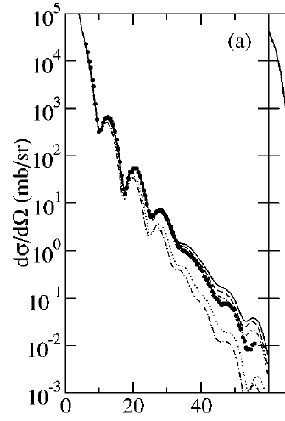
Measurements of radii
Parity violating electron scattering (PREX exp.) may provide strong constraints on <r_{n}²>^{1/2}- <r_{p}²>^{1/2} and on S(ρ) for ρ< ρ_{s}. Expected uncertainties are of order 0.06 fm. (see Horowitz et al., Phys. Rev. 63, 025501(2001).)
Nuclear charge and matter radii are often measured by diffractive scattering.
For example, <r_{p}²>^{1/2} has been measured stable nuclei, by electron scattering to about 0.02 fm accuracy.
  (see G. Fricke et al., At. Data Nucl. Data Tables 60, 177 (1995).)
Strong interaction shifts in the 4f→3d transition in pionic ²⁰⁸Pb also provide sensitivity to the rms neutron radius. (Garcia-Recio, NPA 547 (1992) 473)
  <r_{n}²>^{1/2} = 5.74±.07_{ran} ±.03_{sys} fm
  <r_{n}²>^{1/2}- <r_{p}²>^{1/2} = 0.22 ±.07_{ran} ±.03_{sys} fm
Proton elastic scattering is sensitive to the neutron density, but the results can be ambiguous.
Karataglidis et al., PRC 65 044306 (2002)
²⁰⁸Pb(p,p)
E_{p} =200 MeV
<r_{n}²>^{1/2}=5.6 fm
<r_{n}²>^{1/2}=5.7 fm
O
θ_{cm} (deg)

Slide 44
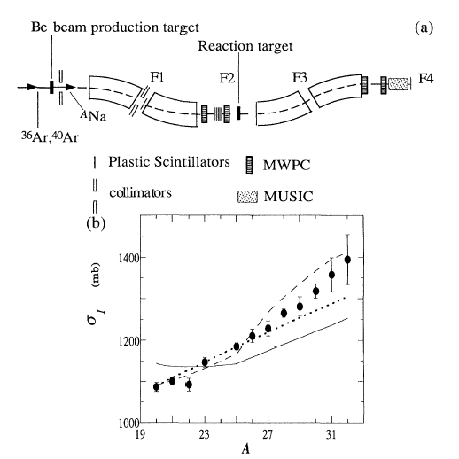
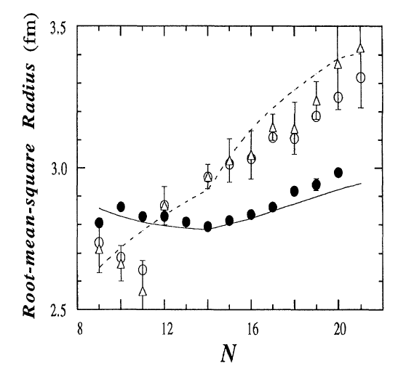
Radii of Na isotopes
Suzuki, et al., PRL 75, 3241 (1995)
δ <r_{p}²>^{1/2 ~} 0.1 fm
O
The relationship between cross-section and Na interaction radius is:
  Getting the actual neutron radius is model dependent.
Proton radii are determined by measuring atomic transitions in Na, which has a 3s g.s. orbit.
Neutron radii increase faster than R=r₀A^{1/3}, reflecting the thickness of neutron skin, e.g. RMF calculation.

Slide 45
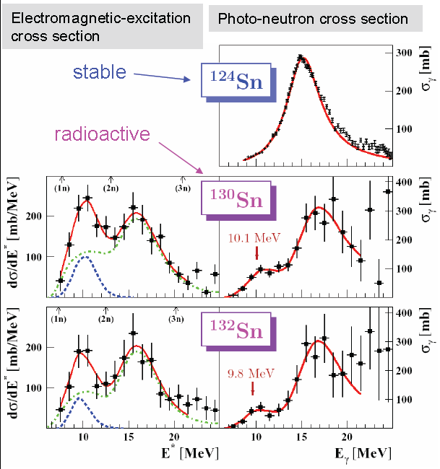
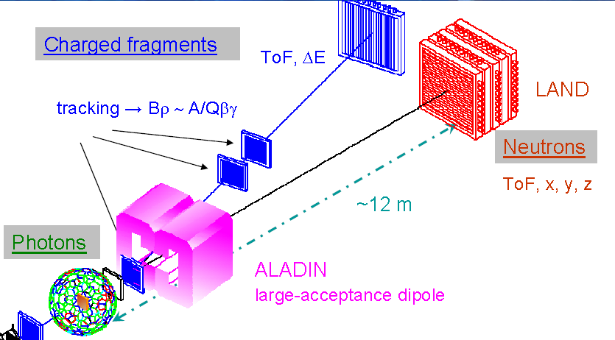
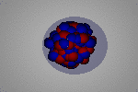
Electric dipole excitations of the neutron skin
P. Adrich et al., PRL 95 (2005) 132501
Coulomb excitation of very neutron rich ^{130,132}Sn isotopes reveals a peak at E*≈10 MeV.
  not present for stable isotopes
Consistent with low-lying electric dipole strength.
calculations suggest an oscillation of a neutron skin relative to the core.
Notes:
instead will discuss what happens when you have the neutron skin and it gets excited, but before I talk specifically about skin in the point now that you can excite a nucleus with a coulomb force because the coulomb force accelerates oh pounds but not the neutrons. In most nuclei when the coulomb excitation occurs quickly as in I velocity collision youth site the giant dipole resonance neutrons off against protons from the nucleus but when there isn’t skin bound weakly to the core you can ask late but at the differenti.e. lower frequency. you can see this happening in the extremely neutron rich tan isotopes. Where there is a second peek at low energies in addition to the giant dipole at higher energies. This is the measured and the probability of excitation term

Slide 46
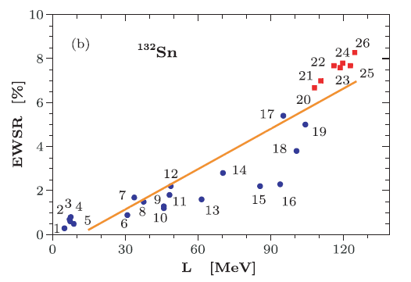
Relation to symmetry energy
A. Klimkiewicz, et al., PRC76, 051603(R) (2007)
A. Carbone,et al., PRC 81, 041301(R) (2010)
% TRK energy weighted sum rule
Data
Random phase approximation (RPA) calculations show a strong correlation between the neutron -proton radius difference and the fractional strength in the pygmy dipole resonance.
Random phase approximation (RPA) calculations show a strong correlation between the fractional strength and
Notes:
theoretically, the probability of excitation is for Portugal to the size of the neutron skin that shown on the left hand side probability of excitation on the one y-axis on the x-axis skin. You can quantify that probably the excitation by the fraction of the energy waited dipole some rule which is basically the energy weighting of the matrix element is the dipole operator consistent with the data dipole resonance is a matrix on the skin by the dipole operator from the cross-section to determine the matrix only for the dipole operator and you can do it each excitation energy and weight that with excitation energy somewhere between about one in 4/2% of the dipole strength in the energy waited some rule is coming from the pygmy dipole the surface of theoretically you can calculate how that depends on the density dependence of symmetry energy in the simplest and sequence is driven so you see that the this depends on the true the symmetry energy as a constrained. later in such relish this constraint compares with others

Slide 47
Giant resonances
Imagine a macroscopic, i.e. classical vibration of the matter in the nucleus.
  e.g. Isoscaler Giant Monopole (GMR) resonance
GMR and also ISGDR provide information about the curvature of ε(ρ,0,0) about minimum.
Inelastic α particle scattering e.g. ⁹⁰Zr(α,α′ )⁹⁰Zr* can excite the GMR. (see Youngblood et al., PRL 92, 691 (1999). )
  Peak is strongest at 0°
range of motion
ρ (fm⁻³)

Slide 48
Giant resonances 2
This motivates a "leptodermous" expansion (see Harakeh and van der Woude, “Giant Resonances” Oxford Science...) :
  K_{sym} is a function of the first and second derivatives of the symmetry energy (G. Colo, et al., Phys. Rev. C70, 024307 (2004).)
  Measurements of GMR resonance energies over a range of isotopes may provide information the first and second derivatives of the symmetry energy as a function of density! (Actually, the first derivative is more important)
O

Slide 49
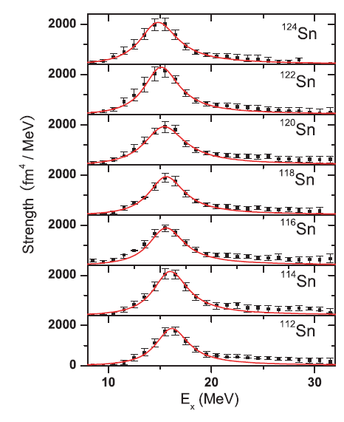
Isotopic dependence of the GMR
The shift in the monopole resonance energy with neutron number provides a measurement of K_{sym}.
  After subtraction of surface and coulomb contributions
The GMR energy decreases by about 0.8 MeV between ¹¹²Sn and ¹²⁴Sn.
  K_{A} decreases with asymmetry δ
  Most comes from K_{sym}
Value for K_{sym}
K_{sym} = - 550 ± 100 MeV
T. Liet.al, PRC 81, 034309 (2010)

Slide 50
Probing the symmetry energy by nuclear collisions
E/A(ρ,δ) = E/A(ρ,0) + δ²⋅S(ρ) ; δ = (ρ_{n}- ρ_{p})/ (ρ_{n}+ ρ_{p}) = (N-Z)/A
To maximize sensitivity, reduce systematic errors:
  Vary isospin of detected particle
  Vary isospin asymmetry δ=(N-Z)/A of reaction.
Low densities (ρ<ρ₀):
  Neutron/proton spectra and flows
  Isospin diffusion
High densities (ρ≈2ρ₀) :
  Neutron/proton spectra and flows
  π⁺ vs. π⁻ production
F₁
F₂
δ=0.3
stiff
F₃
soft
U_{asy} (MeV)
F₁=2u²/(1+u)
F₂=u
F₃=√u
u =

Slide 51
Probe: Isospin diffusion in peripheral collisions
{
Collide projectiles and targets of differing isospin asymmetry
Probe the asymmetry δ=(N-Z)/(N+Z) of the projectile spectator during the collision.
The use of the isospin transport ratio R_{i}(δ) isolates the diffusion effects:
Useful limits for R_{i} for ¹²⁴Sn+¹¹²Sn collisions:
  R_{i} =±1: no diffusion
  R_{i} ≈0: Isospin equilibrium
mixed ¹²⁴Sn+¹¹²Sn
n-rich ¹²⁴Sn+¹²⁴Sn
p-rich ¹¹²Sn+¹¹²Sn
Systems
Example:
measure asymmetry after collision
proton-rich target
P
δ
N
neutron-rich projectile

Slide 52
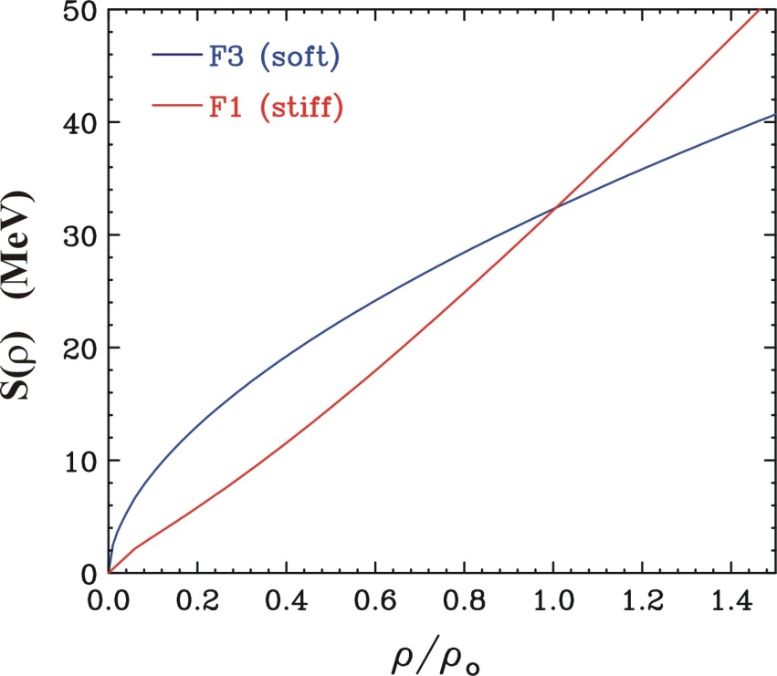
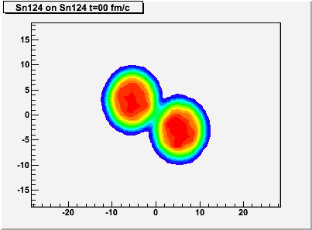
What influences isospin diffusion?
Main effect
Isospin diffusion equation:
Naive expectations:
  D_{δ} increases with S(ρ)
  D_{δ} decreases with σ_{np}
We tested this by performing extensive BUU and QMD calculations with S(ρ) for the form:
  S(ρ) = 12.5·(ρ/ρ₀)^{2/3} + S_{int}· (ρ/ρ₀) ^{γi}
Observed sensitivities:
  Diffusion sensitive to S(0.4ρ₀)
  Diffusion increases with S_{int} and decreases with γ_{i}
  Diffusion decreases with σ_{np}
  Diffusion decreases when mean fields are momentum.
  Diffusion decreases with cluster production.
important for other observables

Slide 53
Summary of last lecture
  The symmetry energy can be probed at sub-saturation densities by various nuclear structure observables.
1. Binding energies
2. Radii of neutron and proton matter in nuclei
3. “Pygmy” Resonance
4. Giant Monopole Resonance
There are a number of reaction observables that may provide information at the symmetry energy.
Low densities (ρ<ρ₀):
  Neutron/proton spectra and flows
  Isospin diffusion
High densities (ρ≈2ρ₀) :
  Neutron/proton spectra and flows
  π⁺ vs. π⁻ production
  Isospin diffusion is sensitive to the symmetry energy at about 0.4 ρ₀
  Begin to describe the isospin diffusion phenomenon and how it might be measured.
O
O

Slide 54
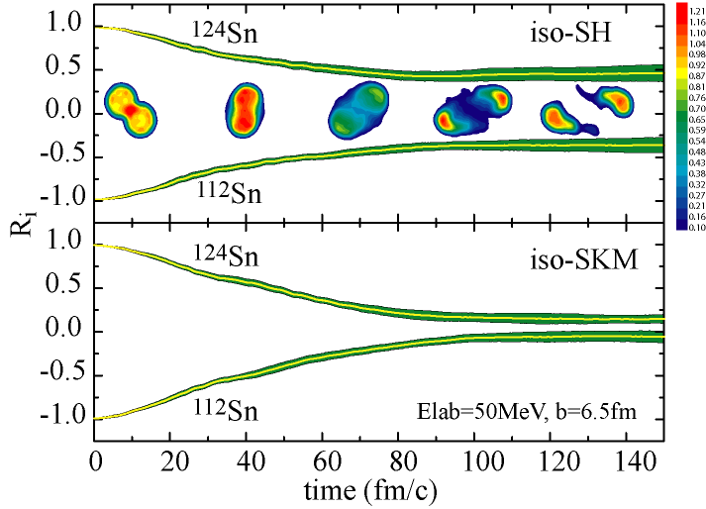
Sensitivity to symmetry energy
The asymmetry of the spectators can change due to diffusion, but it also can changed due to pre-equilibrium emission.
The use of the isospin transport ratio R_{i}(δ) isolates the diffusion effects:
Stronger density dependence
Weaker density dependence
Lijun Shi, thesis
Tsang et al., PRL92(2004)
Notes:
contrast the diffusion between a strongly density dependent symmetry energy like rno^2 and a weakly dependent one like rho^1/2

Slide 55
Experimental measurements of isospin diffusion
Experimental device:
Miniball with LASSA array
Experiment:
^{112,124}Sn+^{112,124}Sn, E/A =50 MeV
Projectile and target nucleons are largely “spectators” during these peripheral collisions.
  Projectile residues have somewhat less than beam velocity.
  Target residues have very small velocities.
Notes:
this what an experiment looks like. planar silicon detetos and prove mass and charge ientidification and an array for impct parameter determination.

Slide 56
Impact parameter determination
Multiplicity decreases monotonically with impact parameter. Can invert the multiplicity to get b/b_{max}.
Can get b_{max} by measuring the cross section σ(N_{C}≥N_{C}(b_{max}))
Can be done for any observable that depends monotonically on b
  main problem is that N_{c} (b) fluctuates, which limits the precision of the impact parameter.
  fluctuation scan be estimated by transport model calculations.
Liu (2006)
peripheral
central
Notes:
getting impact parameter while generally if a nuke to the data miss each other than the emitted particles and at these energies is very head-on collision system completely breaks up into its constituent nucleons if there is a collision in mid-impact parameters than some of the projectile some of the target escape from being exploded so the number of charge particles produced is lower. So the number of charge particles decreases monotonically with impact parameter and knowing that you can just take the number of charged particles and mathematically in uses monotonic dependence to get a good estimate of the impact parameter of course at any given impact parameter and this is what you to mathematically of course

Slide 57
Probing the asymmetry of the projectile spectators: b=5.8-7.2 fm y>0.7y_{beam}
The main effect of changing the asymmetry of the projectile spectator remnant is to shift the isotopic distributions of the products of its decay
This can be described by the isoscaling parameters α and β:
Liu et al.PRC 76, 034603 (2007).
Tsang et. al.,PRL 92, 062701 (2004)
no diffusion
Notes:
to probe the asymmetry in the project though we measured the isotopic distributions of its decay products and this is what you find. Basically increasing the asymmetry of the system shifts the isotopic distributions to the right. This shift can be easily characterized by taking the ratio of the isotopic distributions for two systems in what you find is that this ratio depends on to isoscaling parameters one governing the shift in the distributions as a function of neutron number and the other governing the shift as a function of proton number that’s it that’s all there is to data. So these isoscaling parameters show what the effect of putting in a neutron deficient target in contact with a neutron rich projectile it’s interesting to compare these scat isoscaling parameters for the other four systems by construction we take the ratio of all systems to the most neutron deficient one so when we looked this isoscaling parameter when both numerator denominated the same that parameters one if we construct the ratio of the yields from the most neutron rich system Timlin 24 2.424 divided by Kim a cultlike and 112 then the largest Daisuke isoscaling parameter if we then changed target some of the neutrons are transferred from the projectile and the isoscaling parameter close down if we look at the target fragments, we see that replacing the attpc and 112 projectile with a tin 124 projectile the isoscaling parameter goes up so in both cases there’s diffusion from the neutron rich nucleus to the neutron deficient one but will we compare the isotopic distributions of the target and projectile for the mixed system of heavy tin unlike can we find that the isotopic distributions are different to isotopic distributions from the remnant of the neutron rich projectile are not as neutron rich as the isotopic distributions from the remnant the neutron rich projectile so it doesn’t come to equilibrium.

Slide 58
Origin of isoscaling
Isoscaling is a prediction of nearly all statistical models .
For example, isoscaling parameters have simple origins in the grand canonical ensemble:
  f_{N,Z,int} is the Helmholtz internal free energy of the fragment.
Isoscaling parameters for C.N. evaporation are given by the difference between the separation energies for the two systems:
Isoscaling is also predicted by the dynamical AMD model
  Implies that thermalization occurs rapidly within AMD calculations.
Notes:
so I understand this isoscaling business well there is a very natural reason to expect this exponential isoscaling parameter behavior if she of the system which is in equilibrium and who’s fragments can be described by grand canonical distribution in that case the dependence on neutron number is governed by chemical potential and the same for the proton number when you take the ratio two systems isoscaling parameter is expected to be there and it’s equal to the difference in chemical potentials provided by the temperature but this is Canada extreme models you can ask what happens if you have a residue which is evaporating according to operation theory but you find is that you also get isoscaling but instead of the chemical potentials you that the difference in the separation energies in the something shown in a number of years ago in the paper interesting thing is that even if you do dynamical calculations like AMD you get excellent isoscaling did you get excellent agreement with the isoscaling which has been interpreted to imply chemical equilibrium is achieved at a rather short time scale

Slide 59
Determining R_{i}(δ)
In statistical theory, certain observables depend linearly on δ=(ρ_{n}-ρ_{p})/ρ:
Calculations confirm this
We have experimentally confirmed this
Consider the ratio R_{i}(X), where X = α, X₇ or some other observable:
If X depends linearly on δ₂:
Then by direct substitution:
Notes:
so we have an isoscaling parameter to characterize how the asymmetry of the projectile there it’s an Otte we get the symmetry of the projectile from the slow in theory there a number of observables isoscaling be proud of being one which theoretically the parameter isospin parameter depends linearly on the symmetry of the system in the numerator. We can demonstrate that experimentally and theoretically discuss the parameters I will show in the mid-theoretical calculations of the isoscaling parameter right now all show experiment demonstration well if you have a linear dependence of the isoscaling parameter on the symmetry is trivial to show that by pure subsidization substitution are about the Lazard d now go enjoy some theoretical calculations which demonstrate that

Slide 60
Probing the asymmetry of the Spectators
The main effect of changing the asymmetry of the projectile spectator remnant is to shift the isotopic distributions of the products of its decay
This can be described by the isoscaling parameters α and β:
Liu et al.PRC 76, 034603 (2007).
Tsang et. al.,PRL 92, 062701 (2004)
1.0
0.33
R_{i}(δ)
-0.33
-1.0
Notes:
now if you apply this-this knowledge that we know about the linearity of the isoscaling parameter is trivial to plug it in an audience is relabeled axis

Slide 61
Quantitative values
Reactions:
  ¹²⁴Sn+¹¹²Sn: diffusion
  ¹²⁴Sn+¹²⁴Sn: neutron-rich limit
  ¹¹²Sn+¹¹²Sn: proton-rich limit
Exchanging the target and projectile allowed the full rapidity dependence to be measured.
Gates were set on the values for R_{i}(α) near beam rapidity.
  R_{i}(α) ≈ 0.47±0.05 for ¹²⁴Sn+¹¹²Sn
  R_{i}(α) ≈ -0.44 ±0.05 for ¹¹²Sn+¹²⁴Sn
Obtained similar values for R_{i}(ln(Y(⁷Li)/ Y(⁷Be))
  Allows exploration of dependence on rapidity
Liu et al., (2006)
Liu et al.PRC 76, 034603 (2007).
≈ v⏐⏐/v_{beam}
Notes:
so now we go back to the experimental data reminds you have three systems recombine them to construct this isospin transport ratio and then we can look at how this isospin transport ratio compares for projectile and target and with the spirit nuclei we can actually look at the isospin transport ratios a function of rapidity that is a very nice agreement between these different observables about the isospin transport ratio.

Slide 62
Comparison to QMD calculations
IQMD calculations were performed for γ_{i}=0.35-2.0, S_{int}=17.6 MeV.
Momentum dependent mean fields with m_{n}*/m_{n} =m_{p}*/m_{p} =0.7 were used. Symmetry energies: S(ρ) ≈ 12.3·(ρ/ρ₀)^{2/3} + 17.6· (ρ/ρ₀) ^{γi}
Tsang et al, PRL. 102, 122701 (2009)
Experiment samples a range of impact parameters
  b≈5.8-7.2 fm.
  larger b, smaller γ_{i}
  smaller b, larger γ_{i}
mirror nuclei
Notes:
now we like to compare these measured numbers to theory and I’m initial you some results obtained with the QMD model because that’s published we have recently redone this with the BUU model and that will be published probably later this fall with them both agree on the isospin transport ratio when similar model input are used over trying to do is to assess the sensitivity of the BUU so the equation of state were using his the following and the than reaction to observables. The have a range of impact parameters and to assess yesterday we just took the two extremes of our impact parameter by and calculated as in transport ratio there and then made a comparison with the data and discuss the figures

Slide 63
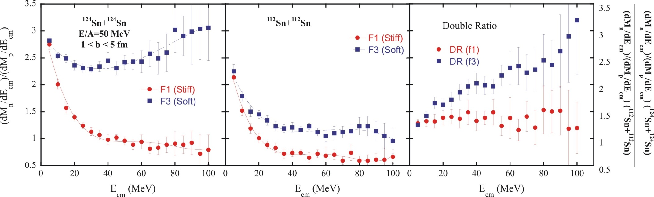
Measurement of n/p spectral ratios: probes the pressure due to asymmetry term at ρ≤ρ₀.
Isospin fractionation: Expulsion of neutrons from bound neutron-rich system by symmetry energy.
Has been probed by direct measurements of n vs. proton emission rates
soft symmetry energy
Bao-An Li et al., PRL 78, 1644 (1997).
stiff symmetry energy
Double ratio removes the sensitivity to neutron efficiency and energy calibration.
Notes:
before I talk about the constraints that we can obtain on the symmetry energy from these measurements I’d like to discuss another observable which is one that we could use as we go to higher densities and that is a comparison of the neutron proton energy spectrum explain how it works. Explain the double ratio.;o it does involve some loss of information but we were uncertain about the neutron efficiency so we did this.

Slide 64
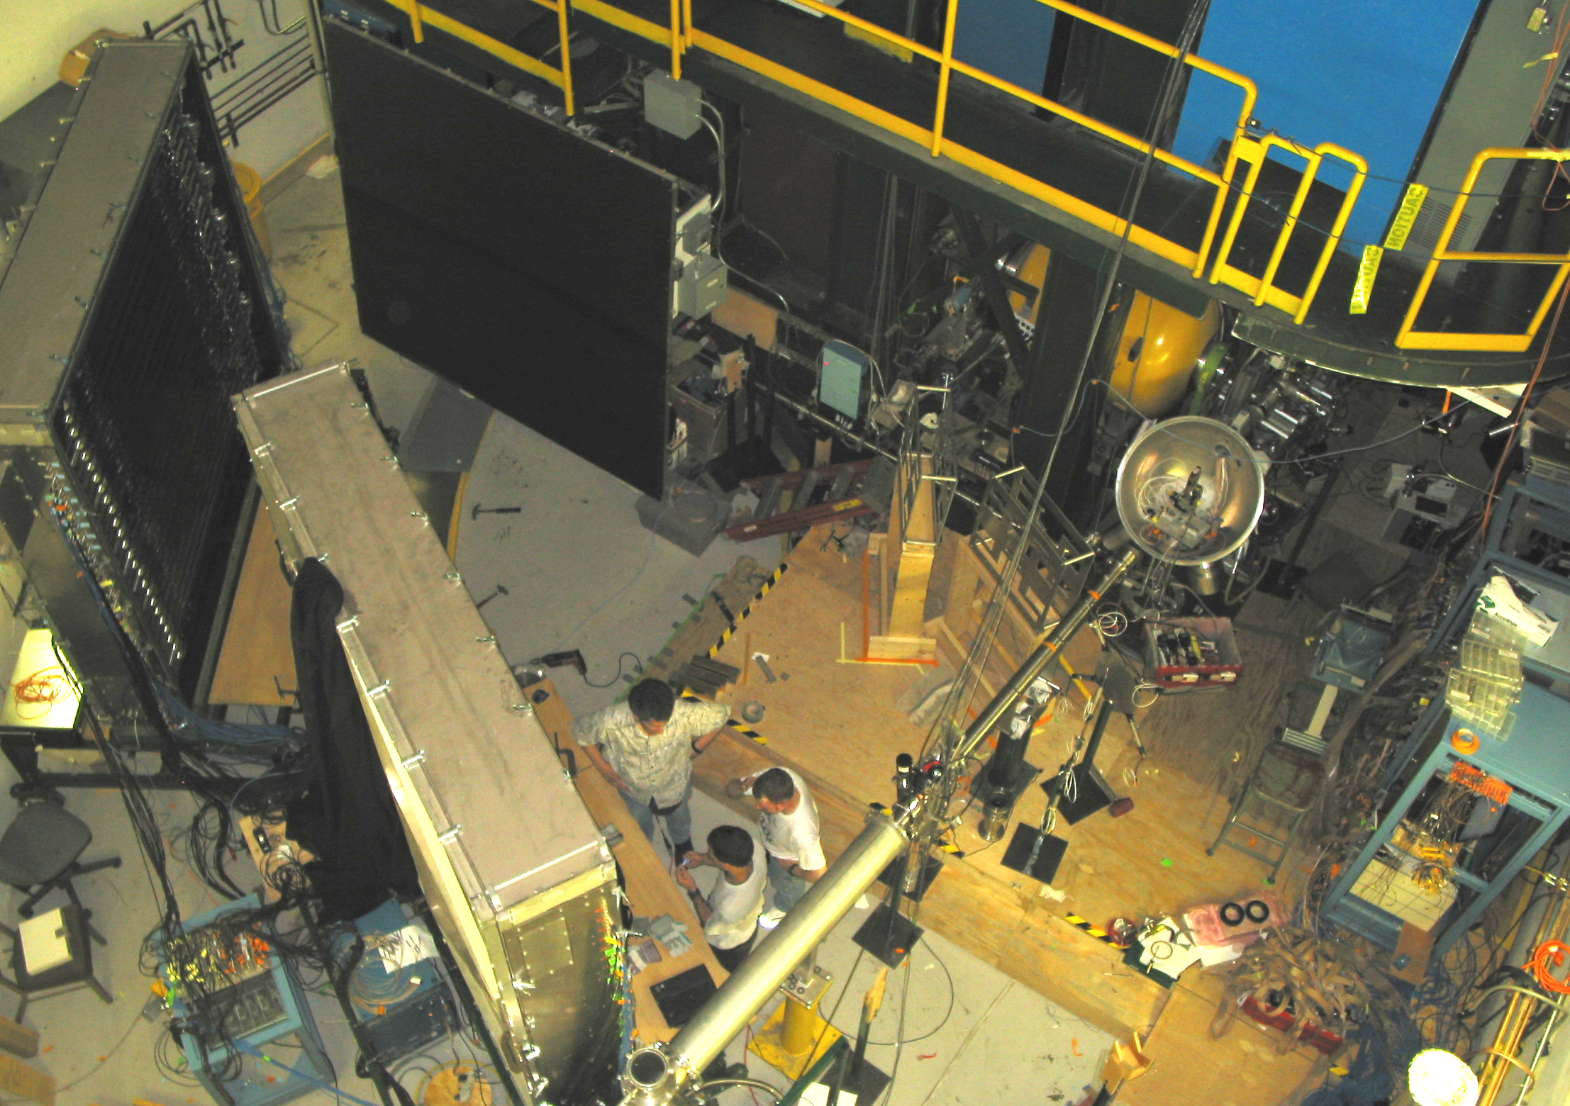
n/p Experiment ¹²⁴Sn+¹²⁴Sn; ¹¹²Sn+¹¹²Sn; E/A=50 MeV
Neutron Wall
42⁰-62⁰
8⁰-38⁰
Neutron Wall
Beam
Scattering Chamber
Famiano et al
Notes:
so this is thethis is the experimental setup in neutron detectors and a chamber

Slide 65
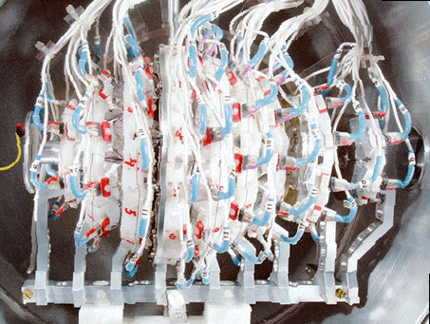
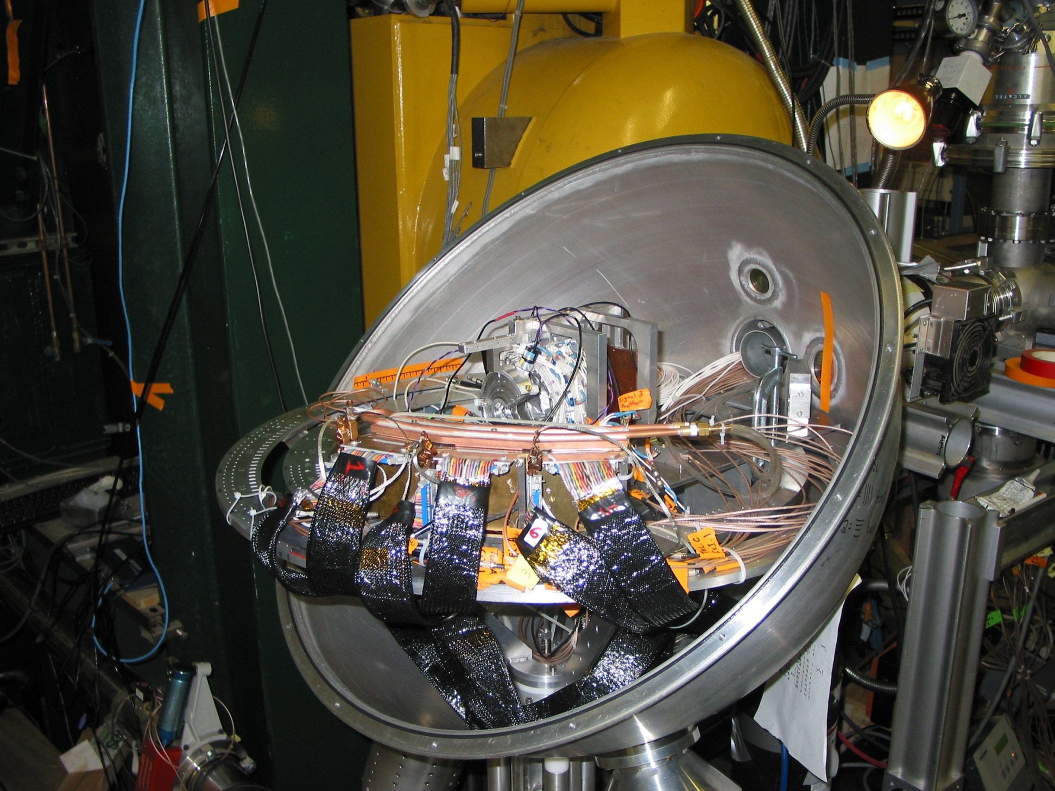
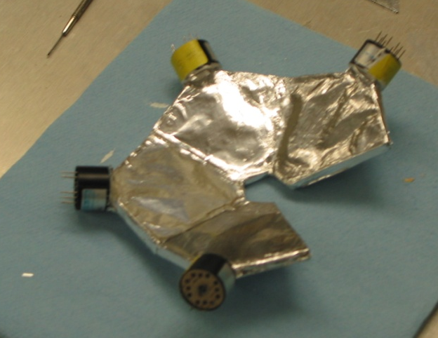
P-detection: Scattering Chamber
n-TOF start detector
WU MicroBall
(b determination)
~6in
Central
collisions
3 particle telescopes
(p, t, ³He, …)
Notes:
here’s was in the chamber

Slide 66
IQMD comparisons to free n/p ratios
Tsang et al, PRL. 102, 122701 (2009)
IBUU04 soft
X=0
Calculation includes similar symmetry energy to BUU97, as well as momentum dependent mean fields m_{n}*=m_{p}*≈0.7m_{N}
Calculations reproduce free and coalescence invariant ratios ( not shown), and ratios of mid-rapidity fragment spectra (not shown).
Results disagree with IBUU04, which assumes m_{n}*>m_{p}*.
Notes:
and this is what we observed. One disappointing issue is that we have a consistent it turns out description for the NP double ratio in the isotope diffusion in the QMD and in also in one version of BUU but the most recent calculations upon me don’t agree with the neutron they in fact there double ratios are much lower the difference between the calculations is that Bollen is using very different neutron and proton effective masses to the effective mass is larger than the proton effective mass and we don’t we have them the equal so there’s the theoretical question about the neutron proton effective masses needs to be resolved but
this is what we have if this time I can discuss briefly how we intend to resolve it

Slide 67
Vary S₀ to obtain allowed values for different S₀ and compare to other probes and analyses
Tsang et al., PRL 102, 122701 (2009).
GDR: Trippa,
PRC77, 061304
Danielewicz, Lee,
NPA 818, 36 (2009)
ImQMD fits for
S₀=30.1 MeV
Carbone et al, PRC 81, 041301 (2010)
fits to IAS
masses
Bao-An Li et al., Phys.
Rep. 464, 113 (2008).
ImQMD
CONSTRAINTS
PDR (Ni,Sn)
ImQMD fits for
variable S₀
fits to
(Sn)
PDR: A. Klimkiewicz,
PRC 76, 051603 (2007).
Expansion around ρ₀:
Symmetry slope L & curvature K_{sym}
Q
Symmetry pressure P_{sym}
Notes:
nowI discuss the constraints

Slide 68
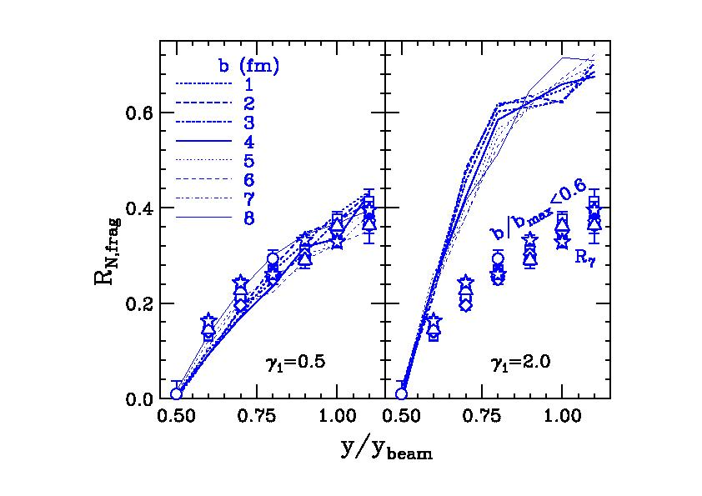
New measurements of Sn+Sn collisions at E/A =35 MeV and comparisons of ImQMD calculations
Z. Sun et al., (2009).
No complete stopping or isospin equilibration in central collisions
Data are in good agreement with γ_{i}~0.5, consistent with E/A=50 MeV data.
Notes:
we would like to improve these constraints by improving the precision and accuracy the measurements rebated attempt to get new isospin diffusion data and idealistic at lower energies thinking that the more time for contact and therefore if the system would come closer to equilibrium to our surprise it doesn’t seem to be the case here are the isospin transport ratios as a function of rapidity and they are that much closer to zero than the ones measured 50 and they’re also not very strongly impact parameter dependent. At higher energies they are more impact parameter dependent. But this lack of impact parameter dependence apparently did something that theory reproduces and in fact one getts agreement with the data using the same assumptions about the symmetry energy the two energies didn’t have to be that way in medium cross section didn’t have to allow this transparency it some level would seem surprising that as one goes down the Pauli blocking gets in the vicinity collisions and this transparency 30 mev the per nucleon apparently is also observed in other observables ported for example by the Intergroup so I think there, the prospect of getting closer to equilibrium
I am nearly finished, but I can’t resist showing some results hot off the press. On Monday, there was a talk by Betty Tsang shown isospin diffusion results that we obtained at CATANIA with the Chimera detector. Here we are actually concerntrating on the diffusion of projectile through target in small impact parameter collsions, the result is remarkably impact parameter independent. It interesting to see that applying the imQMD without modifications to this new energy gives a result that is completely consistend with the conclusions at E/A=50- MeV. It didn’t have to be that way.

Slide 69
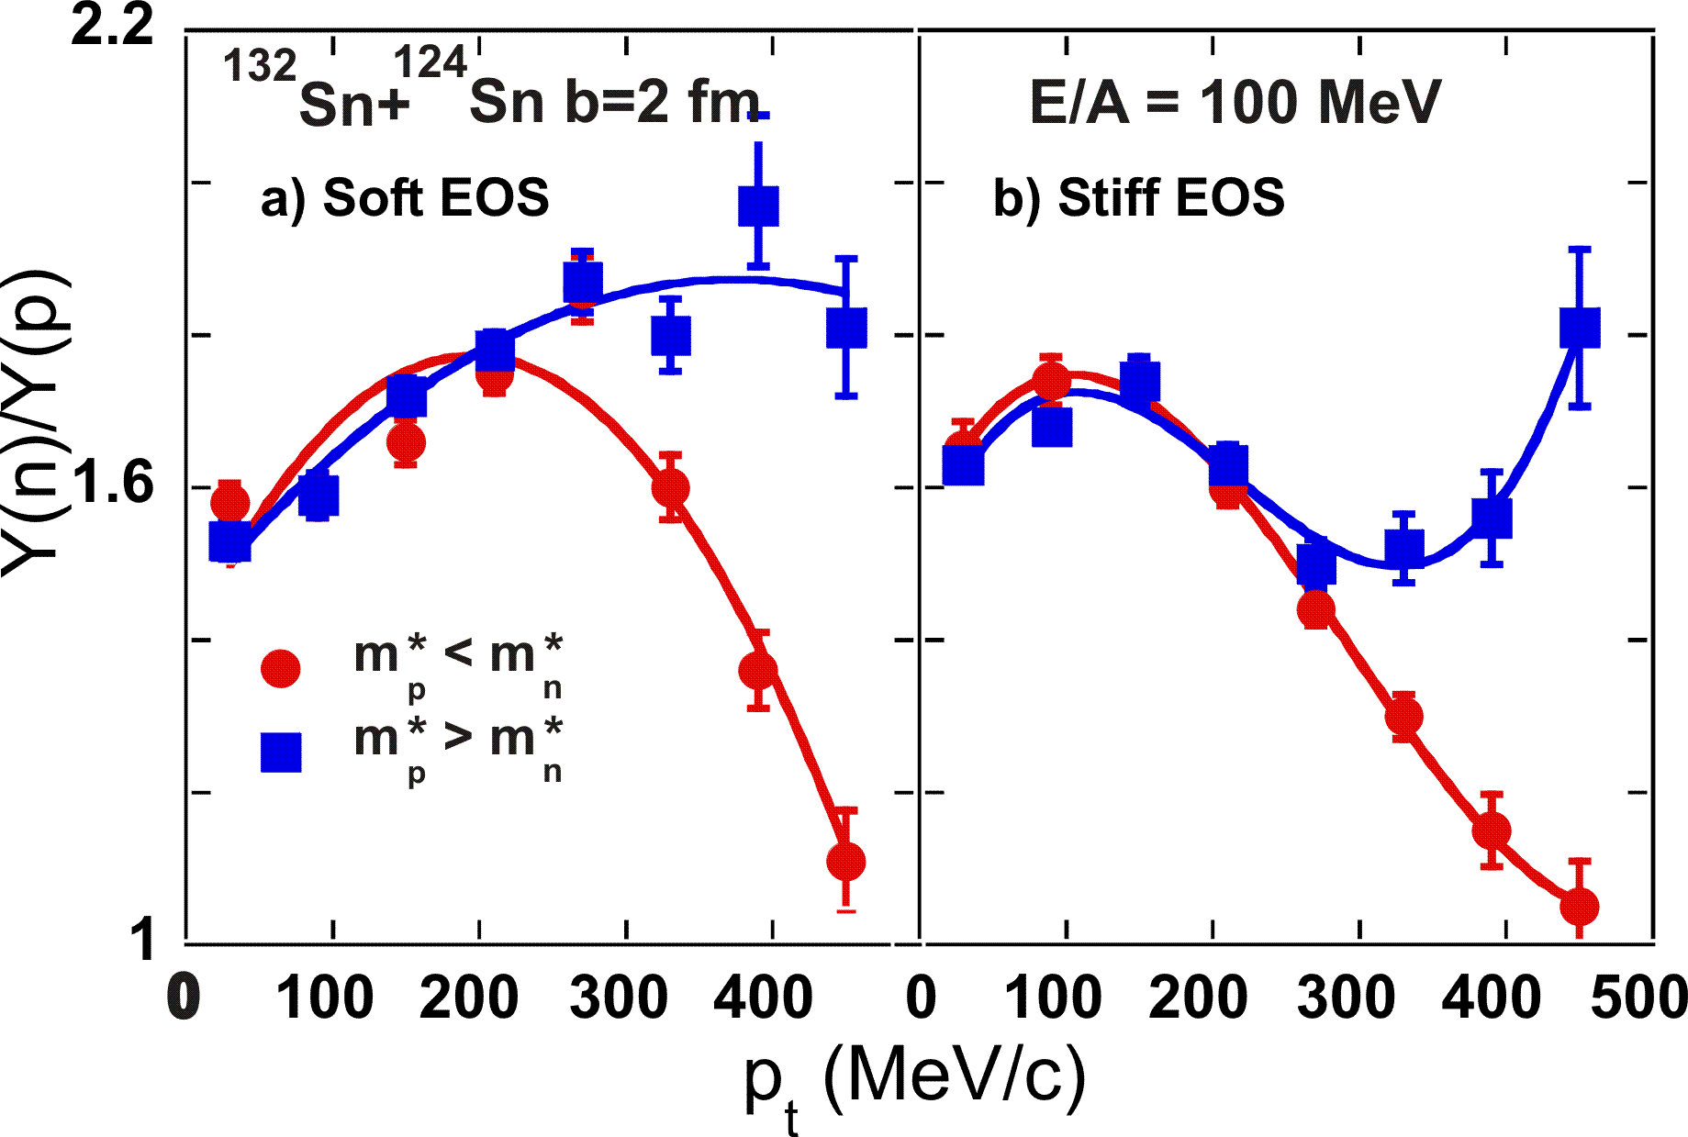
Isospin dependence of the effective mass
J. Rizzo et al., PRC 72 (2005) 064609.
If the symmetry potential is momentum dependent, it will cause the effective masses of neutrons and protons to differ and cause a change in the ratio of neutron/proton spectra.
Measurements of ¹²⁴Sn+ ¹²⁴Sn and ¹¹²Sn+ ¹¹²Sn collisions were performed at E/A=120 MeV last fall to address this question.
Notes:
now we were puzzled by the difference and theoretical predictions for the NP double ratio and the differences in the input to the calculations were that the most recent bow M.A. calculations have a different neutron proton effective mass which he justifies because some analysis of the isospin dependence the optical potential nucleon optical potential so there is an open question which needs to resolve I’m data at Rea measured Tintin collisions at hundred 20 mev per nucleon but we don’t have been analyzed as they were just finished and fall if they’d are like theory we might expect to see something like this but this figure shows so this isn’t two and 124 and 10 124 system of 32 and 24 which sadly we’re not able to do yet but I would expect in 124 two and 24 to similar dependence so we have on the left side soft and attributed to write stiff symmetry energy but the key issue is whether the curve curves up at high energies or down to curves up the neutron effective masses less than the proton effective mass to curves down its ice first so

Slide 70
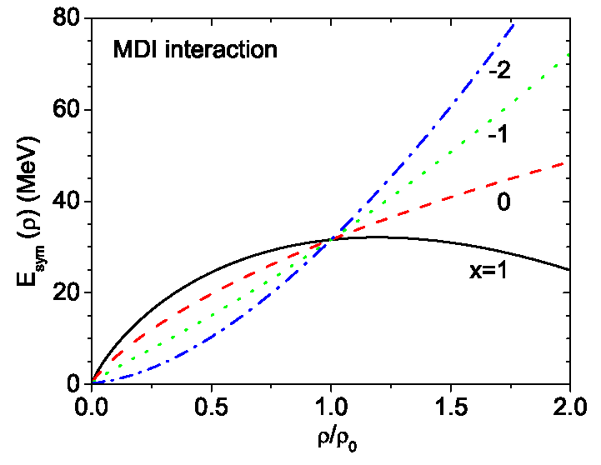
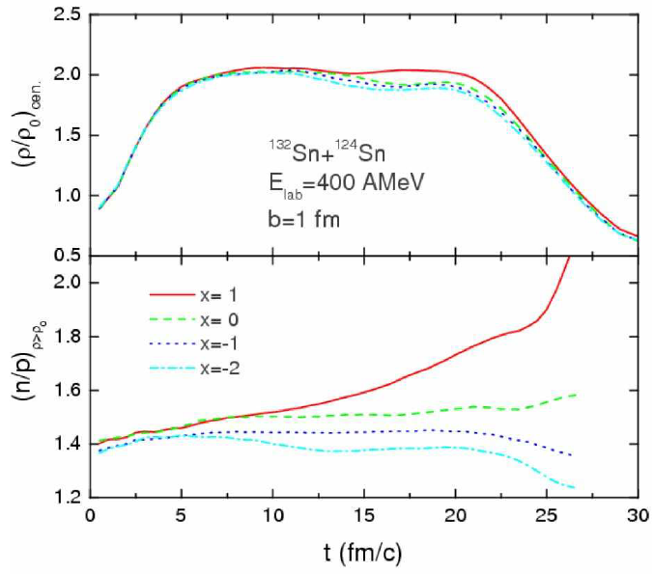
Asymmetry term studies at ρ≈2ρ₀
(Unique contribution from collisions investigations)
Densities of ρ≈2ρ₀ can be achieved at E/A ≈400 MeV.
  Provides information about neutron star radii, direct Urca cooling in proto-neutron stars, stability and phase transitions of dense neutron star interior.
S(ρ) influences diffusion of neutrons from dense overlap region at b=0.
  Diffusion is greater in neutron-rich dense region is formed for stiffer S(ρ).
Experiments are being planned to investigate these phenomena
Yong et al., Phys. Rev. C 73, 034603 (2006)
Notes:
but the key issues if future is actually at higher densities. So if you’re to do experiments for example at riken the Devon Energy close to between 340 mev per nucleon PDB 350 state primary beam or the 300 a secondary beam then we can expect the in central collisions to achieve densities of the order of twice saturation densities as shown on the right panel now be very the density dependence of symmetry energy over some extreme variations as shown here that this will have a consequence on the neutron and proton abundances in the center of a and most dense region of the system if the symmetry energy is deeply density dependent the neutrons accelerated out of the dense system if it’s weakly density dependent bears they remained there or if it actually goes down with density I can mengoni interaction than it could be that the neutron concentration actually increases slightly.

Slide 71
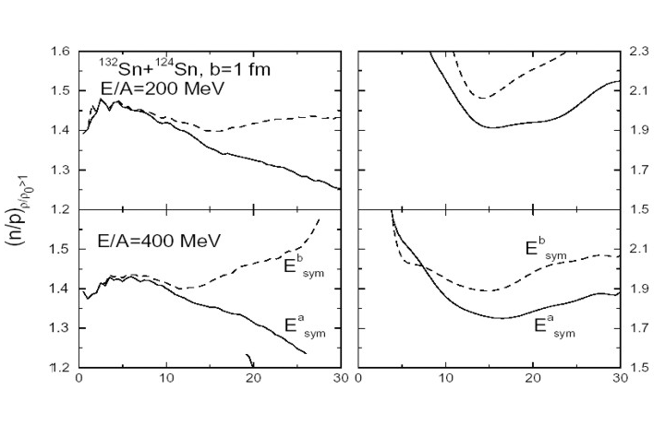
High density probe: pion production
Li et al., Nucl.Phys. A734 (2004) 593.
Larger values for ρ_{n}/ ρ _{p} at high density for the soft asymmetry term (x=0) causes stronger emission of negative pions for the soft asymmetry term (x=0) than for the stiff one (x=-1).
π⁻ / π⁺ means Y( π⁻)/Y( π⁺)
  In delta resonance model, Y( π⁻)/Y( π⁺)≈(ρ_{n,}/ρ_{p})²
  In equilibrium,
  μ(π⁺)-μ(π⁻)=2( μ_{p}-μ_{n})
The density dependence of the asymmetry term changes ratio by about 10% for neutron rich system.
soft
soft
stiff
stiff
π⁻ / π+
t (fm/c)
Investigations are planned with stable or rare isotope beams at the MSU and RIKEN.
  Sensitivity to S(ρ) occurs primarily near threshold in A+A
Notes:
well how do we access this asymmetry in that most dense region 01 the ideas is to measure production theoretically are produced the highest density so they would reflect this asymmetry of the highest density which is strongly dependenton the density dependence of symmetry energy. So the neutron proton density ratio has an effect to apply production as follows and simulations show the various increase

Slide 72
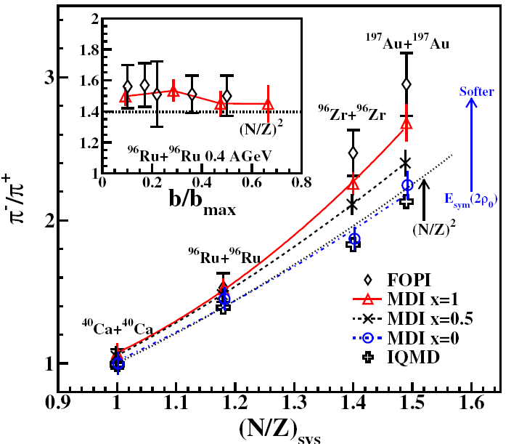
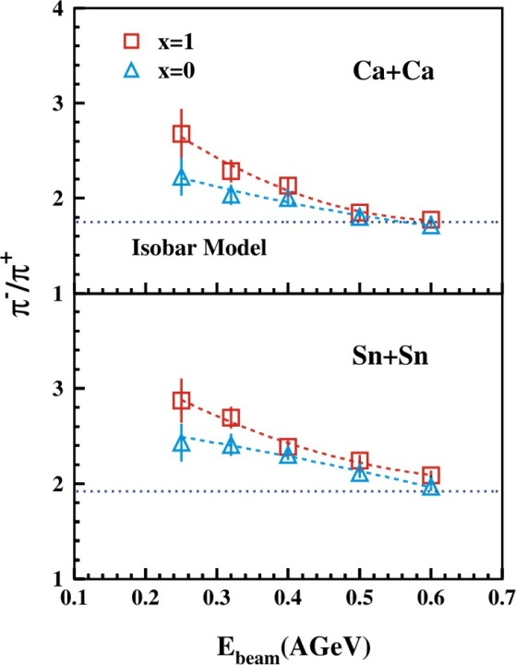
Choice of beams for pion ratios
Xiao, et al., arXiv:0808.0186 (2008)
Reisdorf, et al., NPA 781 (2007) 459.
Zhang et al., arXiv:0904.0447v2 (2009)
Sensitivity to symmetry energy is larger for neutron-rich beams
Sensitivity increases with decreasing incident energy.
Data have been measured for Au+Au collisions.
It would be interesting to measure with rare isotope beams such as ¹³²Sn and ¹⁰⁸Sn.
  Interesting comparison because the Coulomb interaction is the same for both to first order. Coulomb also strongly influences the pion ratios.
Notes:
now pions production increases with incident energy quite strongly to you can ask when would be the best energy or what would be the best energy for measuring it turns out that higher energies while producing more pions are less sensitive to the symmetry energy because the rescattering effects absorption effects and that’s illustrated by a number of calculations. The left hand side shows how five isobaric pi plus ratio varies function incident energy go isospin and the right-hand side shows varies with incident energy so we are really it manages using rare isotope beams at moderate energies

Slide 73
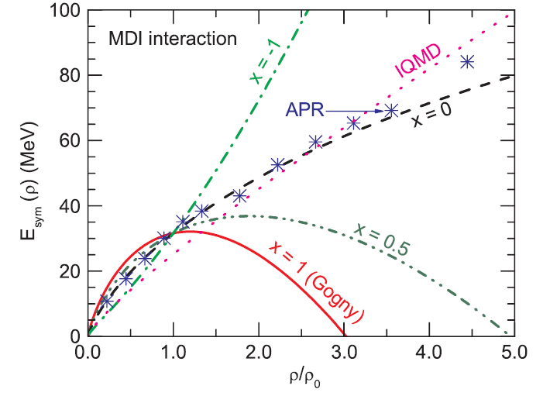
Au+Au data suggest very weak density dependence at ρ>3ρ₀
Zhigang Xiao, et al, PRL, 102, 062502 (2009)
GSI
?
MSU
Zhigang Xiao, et al, PRL, 102, 062502 (2009)
Isospin diffusion, n-p flow
Au+Au
Reisdorf, et al., NPA 781 (2007) 459.
Pion production
Notes:
and in fact the date on pi production exists and was published by low the reisdorf this was data taken with the folks the detector for golden goal collisions and then he was analyzed by Bell and the theoretically to attain Radice pricing a result that the symmetry energy is very weak density is correct to calculations by the the pions been on a lot of things and coulomb for example affects the isospin minus and strongly different way the data itself is not complete the has to be extrapolated the lowest energies so it be that there’s some problems with the comparison or some problems with the theory Sosa more data would help one candidate he would be useful will it be useful to measure the system with a constant charge

Slide 74
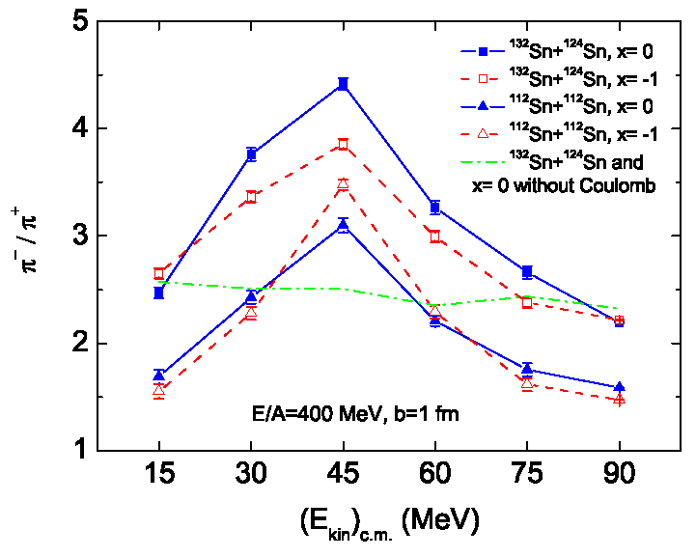
More quantitative comparisons are needed
Yong et al., Phys. Rev. C 73, 034603 (2006)
Au data involved considerable corrections for the pion acceptances.
Pion spectra, ratios of pion spectra and pion flows ratios can provide more quantitative comparisons, and tests of theory.
However the Coulomb interaction strongly influences such observables.
Here, π⁻ / π⁺ = Y( π⁻)/Y( π⁺).
soft
stiff
Such experiments are planned at RIKEN and MSU
Notes:
we can compare neutron rich tint systems neutron deficient in systems and to make sure that we don’t make mistakes with the exceptions effects we can look at the energy spectra of this still leaves some coulomb effect in their which in theory should be older calculate the practice sometimes we have difficulty because the coulomb acceleration depends a bit on what whether you what you think his the future of the charges so one way

Slide 75
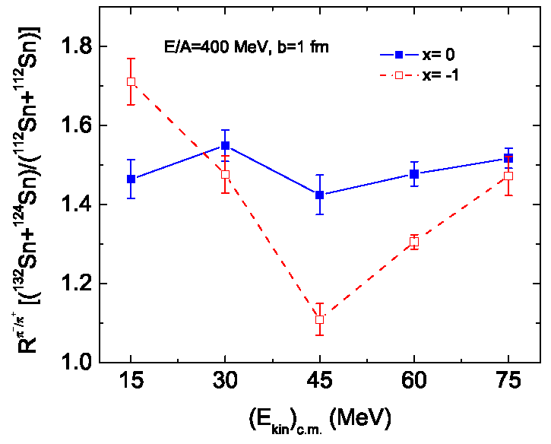
Double ratio: pion production
Yong et al., proposed measuring pion double ratios involving two systems with the same charge but different neutron number
  Can remove the sensitivity to Coulomb and retain sensitivity to symmetry energy
Example: ¹³²Sn+¹²⁴Sn and ¹¹²Sn+¹¹²Sn systems.
Largely removes sensitivity to difference between π⁻ and π⁺ acceptances.
Yong et al., Phys. Rev. C 73, 034603 (2006)
soft
stiff
Such experiments are planned at RIKEN and MSU
R
Notes:
to remove this one raid remove the sensitivity is to divide out spectra for pi plus for two different systems and do a double ratio like we did with NP double ratio and that was proposed by young L. and I think it’s interesting and really lay we would like to look at the raw spectra at the single ratios of the double ratios to make sure we understand all of them but this seems to be be sensitive to the coulomb interaction and to the deficiency section isospin minus and to things like energy calibrations alike all his stuff cancels out the double ratio

Slide 76
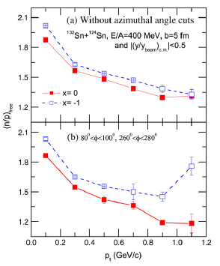
Comparisons of neutron and proton observables :
Most models predict the differences between neutron and proton flows and t and ³He flows to be sensitive to the symmetry energy and the n and p effective mass difference.
In this prediction, the ratio of neutron over proton spectra out of the reaction plane displays a significant sensitivity the symmetry energy.
B.-A. Li et al., Phys. Rep. 464 (2008) 113.
stiff
soft
Such measurements will be performed next year at GSI:
  P. Russotto et al.
Notes:
but in some sense we would to pions reflect the flow of the neutrons and protons out of the dense region and even though the neutrons and protons we scatter a lot and it can reflect the dynamics at a later stage probably more than they be more than the pions it would be interesting to cross compare the fine results to the nucleon results and there is some sensitivity in the nucleon spectra to equation of state according to theory described

Slide 77
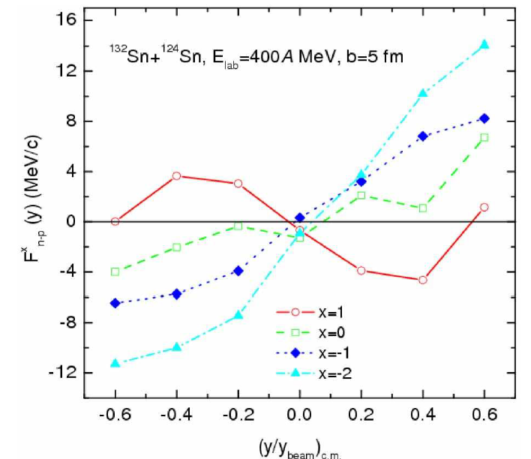
n-p differential transverse flow
Transverse directed flow is usually obtained by plotting the mean transverse momentum <p^{x}> vs. the rapidity y.
The neutron-proton differential flow is defined here to be:
Sensitivity to acceptance effects might be minimized by constructing the difference:
Li et al., arXiv:nucl-th/0504069 (2005)
very soft
very stiff
Q
Notes:
then we could also look to that was elliptical flow we can also put transfer slow I hesitate a little bit to show this observation here because in principle we can’t exactly do with plotted here but we can probably do something similar so there’s a big effect

Slide 78
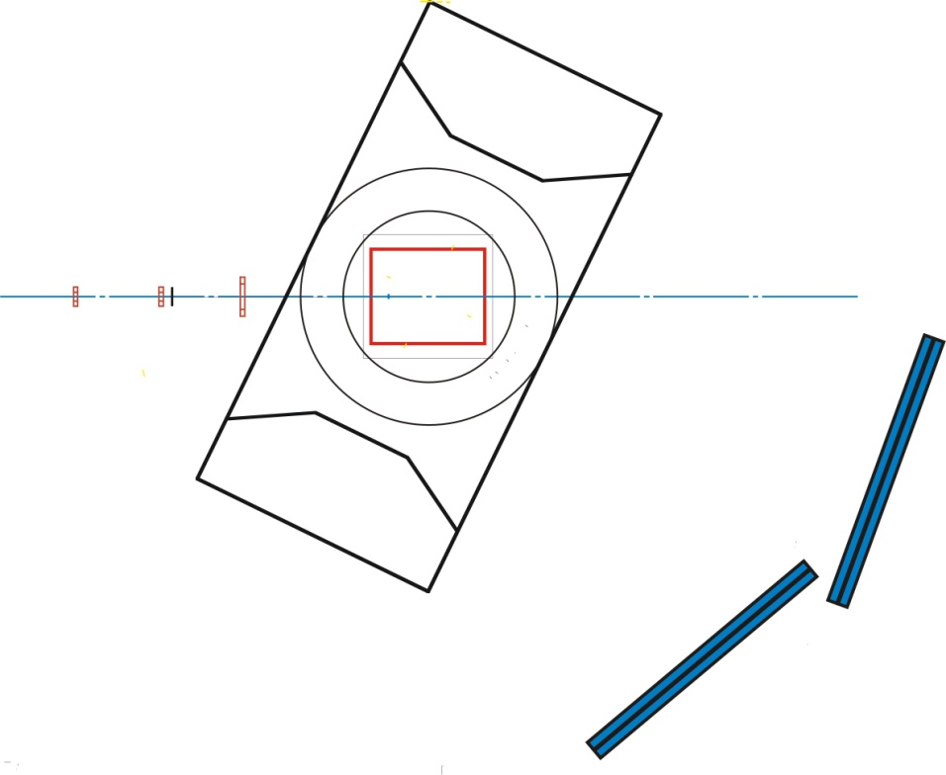
Device: SAMURAI TPC
T. Murakamiª, Jiro Murata^{b}, Kazuo Ieki^{b}, Hiroyoshi Sakurai^{c}, Shunji Nishimura^{c}, Atsushi Taketani^{c}, Yoichi Nakai^{c}, Betty Tsang^{d}, William Lynch^{d}, Abigail Bickley^{d}, Gary Westfall^{d}, Michael A. Famiano^{e}, Sherry Yennello^{g}, Roy Lemmon^{h}, Abdou Chbihi^{i}, John Frankland^{i}, Jean-Pierre Wieleczko^{i} , Giuseppe Verde^{j}, Angelo Pagano^{i}, Paulo Russotto^{i}, Z.Y. Sun^{k}, Wolfgang Trautmann^{l}
ªKyoto University, ^{b}Rikkyo University, ^{c}RIKEN, Japan, ^{d}NSCL Michigan State University, ^{e}Western Michigan University, ^{g}Texas A&M University, USA, ^{h}Daresbury Laboratory, ^{i}GANIL, France, UK, ^{j}LNS-INFN, Italy, ^{k}IMP, Lanzhou, China, ^{l}GSI, Germany
The SAMURAI TPC would be used to constrain the density dependence of the symmetry energy through measurements of:
  Pion production
  Flow, including neutron flow measurements with the nebula array.
The TPC also can serve as an active target both in the magnet or as a standalone device.
  Giant resonances.
  Asymmetry dependence of fission barriers, extrapolation to r-process.
TPC
SAMURAI dipole
Q
Nebula scintillators
Notes:
TO do these measurments we propo if you lost for larger editions of the symmetry energyse to put a TPC in the SAMURAI magnet
Read the slide, note the nebula detector

Slide 79
Devices: SAMURAI TPC at RIKEN
SAMURAI TPC parameters
Pad plane area | 1.3m x 0.9 m
Number of pads | 111664 (108 x 108)
Pad size | 12 mm x 8 mm
Drift distance | 55 cm
Pressure | 1 atmosphere
dE/dx range | Z=1-3 (Star El.), 1-8 (Get El.)
Two track resolution | 2.5 cm
Multiplicity limit | 200 (large systems absolute pion eff.)
GEANT simulation
¹³²Sn+¹²⁴Sn collisions at E/A=300 MeV
Good efficiency for pion track reconstruction is essential.
Initial design is based upon EOS TPC, whose properties are well documented.
Notes:
business or planning to do are waiting for the money but were working on it anyway

Slide 80
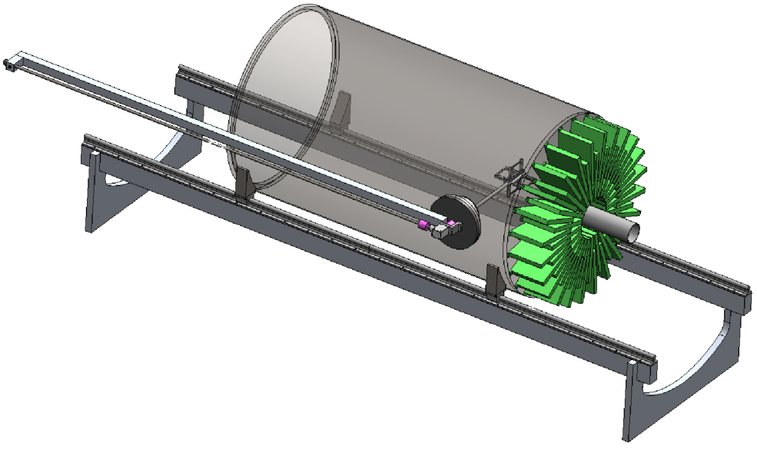
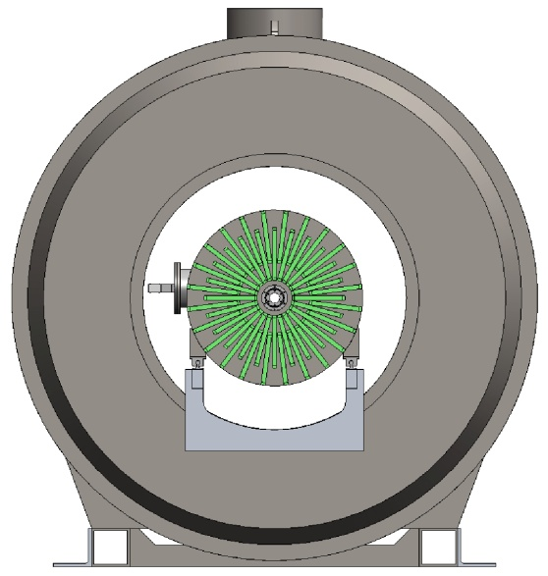
MSU:Active Target Time Projection Chamber
D Bazin, M. Famiano, U. Garg, M. Heffner, R. Kanungo, I. Y. Lee,
W.Lynch, W. Mittig, L. Phair, D Suzuki,G. Westfall
120 cm
Two alternate modes of operation
  Fixed Target Mode with target wheel inside chamber:
    4π tracking of charged particles allows full event characterization
    Scientific Program » Constrain Symmetry Energy at ρ>ρ₀
  Active Target Mode:
    Chamber gas acts as both detector and thick target (H₂, D₂, ³He, Ne, etc.) while retaining high resolution and efficiency
    Scientific Program » Transfer & Resonance measurements, Astrophysically relevant cross sections, Fusion, Fission Barriers, Giant Resonances
Notes:
we have also plans for doing measurements of pions at lower energies and you

Slide 81
Summary
The EOS describes the macroscopic response of nuclear matter and finite nuclei.
  Isoscalar giant resonances , kaon production and high energy flow measurements have placed constraints on the symmetric matter EOS, but the EOS at large isospin asymmetries is not well constrained.
The behavior at large isospin asymmetries is described by the symmetry energy.
  It influences many nuclear physics quantities:
    binding energies,
    neutron skin thicknesses, isovector giant resonances,
    isospin diffusion,
    proton vs. neutron emission and π⁻ vs. π⁺ emission
    neutron-proton correlations.
  Measurements of these quantities can constrain the symmetry energy.
Constraints on the symmetry energy and on the EOS will be improved by planned experiments. Some of the best ideas probably have not been discovered.
ε(ρ,0,δ) = ε(ρ,0,0) + δ²⋅S(ρ) ; δ = (ρ_{n}- ρ_{p})/ (ρ_{n}+ ρ_{p}) = (N-Z)/A
Notes:
of Come to the conclusion of what I want to say thank you very much her than these are my summary and thank you for your

Slide 82
Influence of production mechanism on isoscaling parameters
Primary: Before decay of excited fragments, Final: after decay of excited fragments
Statistical theory:
  Final isoscaling parameters are often similar to those of the primary distribution
  Both depend linearly on δ
⇒ R(α)=R(δ)
Dynamical theories:
  Final isoscaling parameters are often smaller than those of primary distribution
  Both depend linearly on δ
⇒ R(α)=R(δ)
  Doesn't matter which one is correct.
final
R

Slide 83
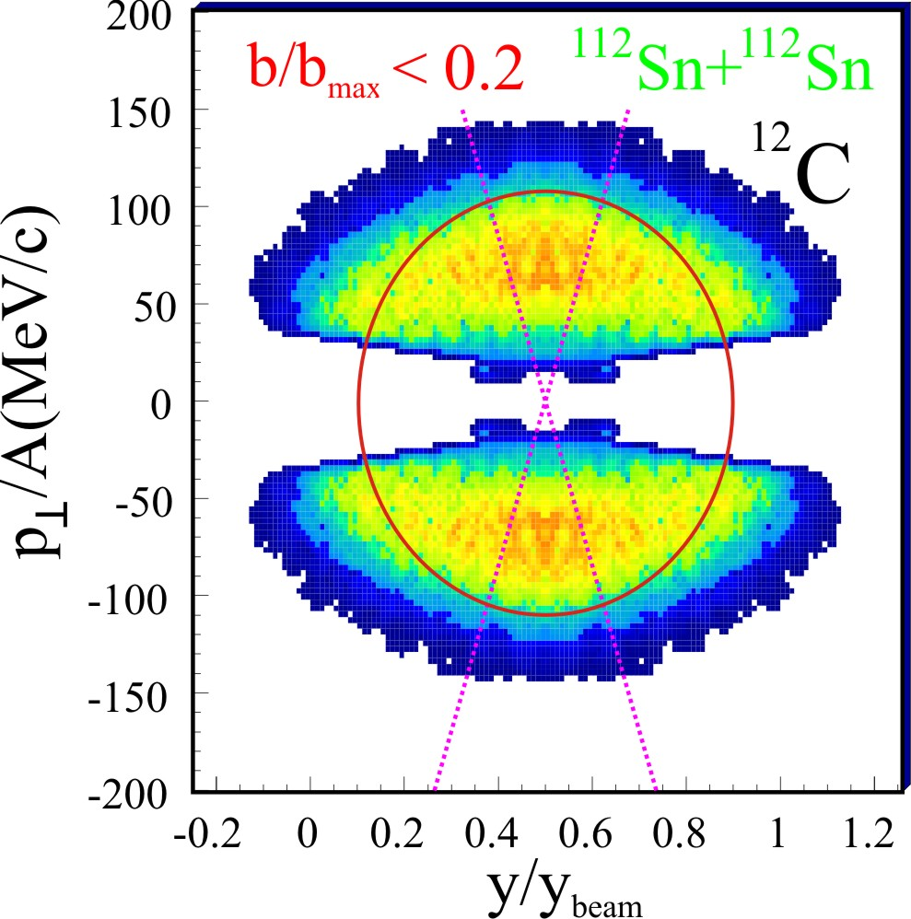
Test of linearity using central collisions
Data analyzed in well-mixed region at 70°≤θ_{cm}≤110°.
Linearity is demonstrated for α, β and ln(Y(⁷Li)/Y(⁷Be))∝α-β
Liu et al., (2006)
Liu et al., (2006)
R

Slide 84
Linearity of α and β in fragmentation models
Calculations using ISMM display a linear dependence α and β on δ
Calculations using AMD display a linear dependence α and β on δ for both primary and secondary fragments.
¹²⁴Sn
⁶⁰Ca+ ⁶⁰Ca
⁴⁰Ca+ ⁴⁰Ca
¹⁰⁴Sn
Tan et al., 2002
Ono et al., PRC 2005
Sn decays
Central Ca+Ca collisions
R
-1 0 1
R(δ)
-1 0 1
R(δ)

Slide 85
Summary of last lecture
by various techniques. Skyrme parameterizations are a relatively easy and flexible way to do so. .
  The high density behavior and the behavior at large isospin asymmetries of the EOS are not well constrained.
The behavior at large isospin asymmetries is described by the symmetry energy.
  The symmetry energy has a profound influence on neutron star properties: stellar radii, maximum masses, cooling of proto-neutron stars, phases in the stellar interior, etc.
  Nuclear masses, the differences between neutron and proton matter radii, giant monopole and pigmy dipole resonances can provide information about the symmetry energy
ε(ρ,0,δ) = ε(ρ,0,0) + δ²⋅S(ρ) ; δ = (ρ_{n}- ρ_{p})/ (ρ_{n}+ ρ_{p}) = (N-Z)/AThe EOS describes the macroscopic response of nuclear matter and finite nuclei.
  It can be calculated
O

Slide 86
The ImQMD model provides a consistent interpretation of the np ratios and two isospin diffusion measurements
0.4≤γ_{i} ≤1.05
0.4≤γ_{i} ≤1
0.45≤γ_{i} ≤0.95
Tsang, Zhang (2008).
Consistent χ² analyses of these three observables within the ImQMD models provides (note: S(ρ₀)=30.1 MeV)
IBUU04 analysis of isospin diffusion provides: (note: S(ρ₀)=32 MeV)

Slide 87
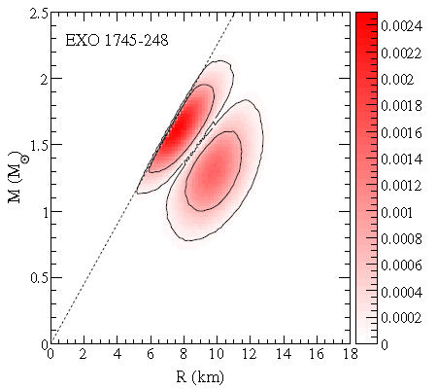

Such analyses depend on thickness of the atmosphere.
In the Eddington limit, the luminosity is given by the stellar mass.
Luminosity and spectral temperature are combined to get the stellar radius.
The range of values reflect estimated observational & theoretical uncertainties
A. Steiner et al, arXiv:1005.0811
“Thin atmosphere” R_{ps}≈R
“Thick atmosphere” R_{ps}>>R

Slide 88

Constraints from Bayesian analysis
A. Steiner et al, arXiv:1005.0811
A. Steiner et al, arXiv:1005.0811
2ρ₀
ρ₀
O
The derived constraints are tight, but depend strongly on X-ray burst model.
Integral constraint on EoS: Need independent constraints at different densities.
  Can be provided by laboratory measurements.

Slide 89

Experimental Areas
A full suite of experimental equipment will be available for fast, stopped and reaccelerated beams
New equipment
  Stopped beam area (LASERS)
  ISLA Recoil Separator
  Solenoid spectrometer
  Active Target TPC
Direct
Reactions
Pions

