Slide 1
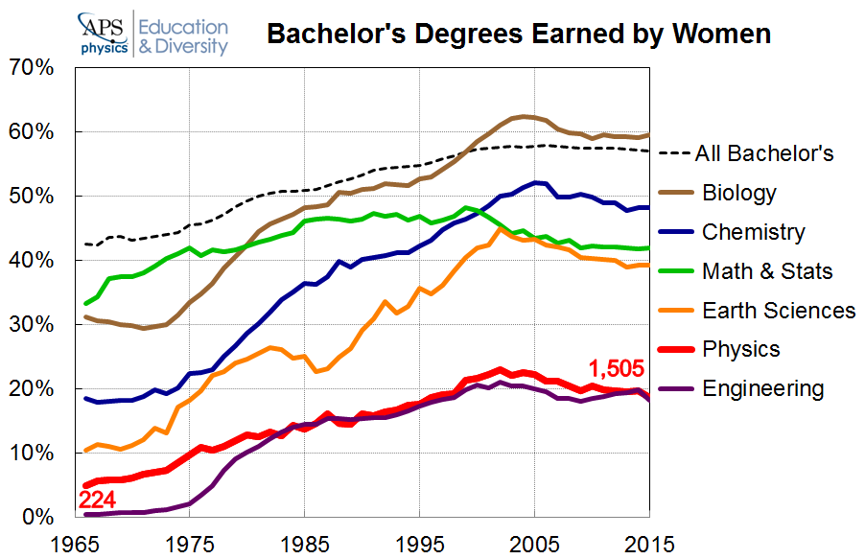
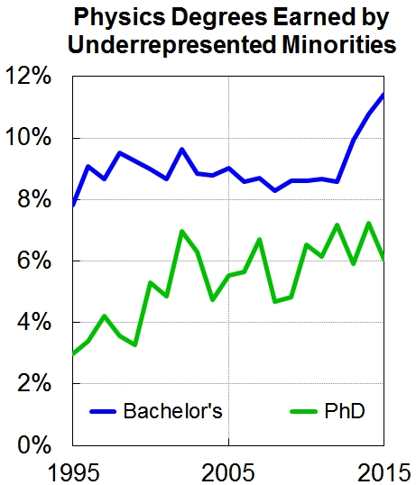
Diversity over Time
Diversity is critical for science to be able to draw on best talent.
The percentage of women receiving Bachelor’s degrees in the STEM fields have been on an overall decline since 2005. In addition, the overall number of bachelor’s degrees awarded in Physics is low (~20% for women, <12% for minorities).
We all benefit from a more diverse and inclusive workplace. Scientific and engineering progress relies on problem solving. Diversity increases the variety of perspectives and solution approaches brought to a problem and can therefore lead to greater creativity and institutional excellence.
Percentage of degrees awarded in physics at US institutions.
Source: APS & IPEDS
What can we do at NSCL/FRIB? To start: Be aware that there is a problem. The statistics for NSCL/FRIB are not any better than the national averages. See next page for what we can do better.

Slide 2
Mind your speech, it might offend others!
A welcoming work climate depends on good practices and behaviors of all employees. It is easy to hurt others with political, religious, artistic, and socially themed speech.
Offending somebody can be unintended and does not require that speech or expression be pornographic or profane. Off-color jokes, innuendo, and cartoons may already create a hostile environment. A joke you heard on TV on Saturday Night Live might not be appropriate to be told in the work place.
Art and music that can be seen as politically offensive or sexually themed, even when legitimate art, has no place at the work place. Think twice before you hang up this Gauguin print in your office.
Even polite religious proselytizing can be harassment. Do not make comments about somebody else’s faith, and don’t try to change somebody else’s life style at work.
Societal norms have changed over time. Speech that might have been acceptable 20 years ago, can be found offensive today.

