Slide 1
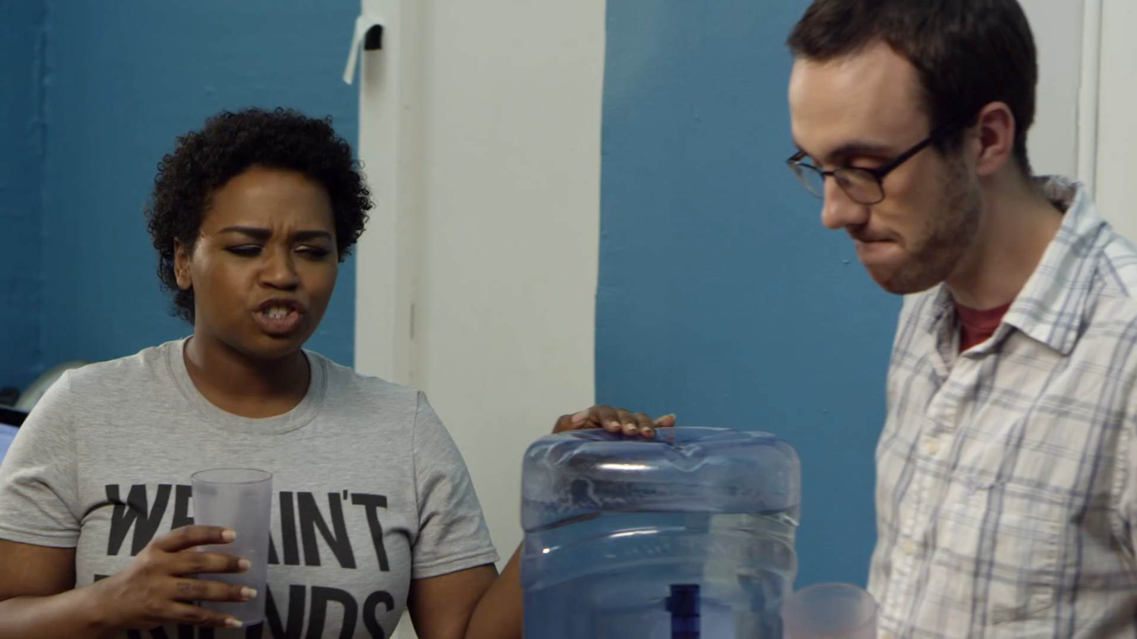
What if microaggressions happened to white people…
from MTV News You can watch the video on https://m.youtube.com/watch?v=KPRA4g-3yEk
If you observe microaggressions at the Laboratory please speak up!

