Slide 1
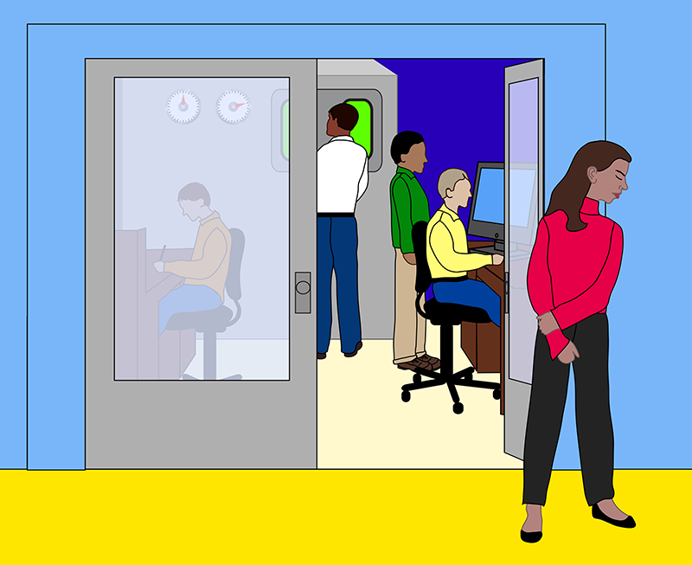
Yes, Sexual Harassment Still Drives Women Out of Physics
A recent Physics Viewpoint article was published with the above title by Julie Libarkin (Professor and head of the Geocognition Research Laboratory at MSU). The article described a recent survey that was conducted at the 2017 Conference for Undergraduate Women in Physics (CUWiP).
The survey found that nearly three-quarters of the roughly 500 respondents had experienced some form of sexual harassment and that these experiences correlated with a sense of not belonging to the field.
Sexual harassment is unwelcome or inappropriate behavior of a sexual nature that creates an uncomfortable or hostile environment. Three forms described in the article include:
“Sexist gender harassment” describes hostile or insulting remarks and actions based on one’s gender, such as saying women cannot do physics.
“Sexual gender harassment” refers to sexual remarks or conduct, like commenting on the shape of a woman’s body.
A third form of sexual harassment is unwanted sexual attention, such as requests for sexual favors or unwanted touching.
Experiencing sexual harassment increases a woman’s likelihood of leaving a career in science, technology, engineering, mathematics, and medicine (STEMM). For those women who do stick with their field, harassment hurts their career, economic standing, and well-being. The fact that this is happening at the undergraduate level is even more concerning.
Link to the full Article: https://physics.aps.org/articles/v12/43#c2
More reading on the same topic “Impressions from the DNP Fall Meeting”: https://www.aps.org/units/dnp/allies/diary.cfm

Slide 2
How can we be more Inclusive?
Think about what you say before you say it. Below are actual examples of things said to your female colleagues:
I was talking about my research and explaining how excited I was and out of the blue a male colleague said, “that’s nice, but when are you getting married… you won’t be young forever?”
I stepped into the elevator with a colleague and he said “So you’re having another one?” while pointing to my stomach. I had just returned from maternity leave.
During an experiment, a visitor said, “I saw a star by your name, are you in charge of us?” I replied with “yes” and he then proceeded to laugh and asked, “are you sure you’re ready for that?” Then he laughed more.
A male colleague said to me “You’re a runner? I can tell because your body looks exactly like my daughters’!” while looking me up and down.
I had a physics professor at MSU who polled the class during a lecture to provide “proof” that women liked shopping more than men. Of course, there were only 3 women in the class, so it is unclear how he was hoping to statistically support his argument. It didn’t come off well.
As a reminder, at the FRIB Laboratory, we hold ourselves to our shared Code of Conduct and invite everybody to make reports via the Employee and Student Concerns program, call the MSU Misconduct Hotline at 800-763-0764, or file a report with the MSU Office of Institutional Equity

