Slide 1
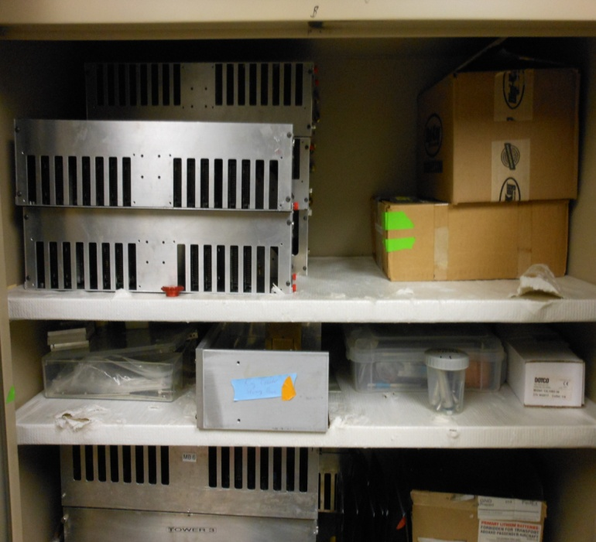
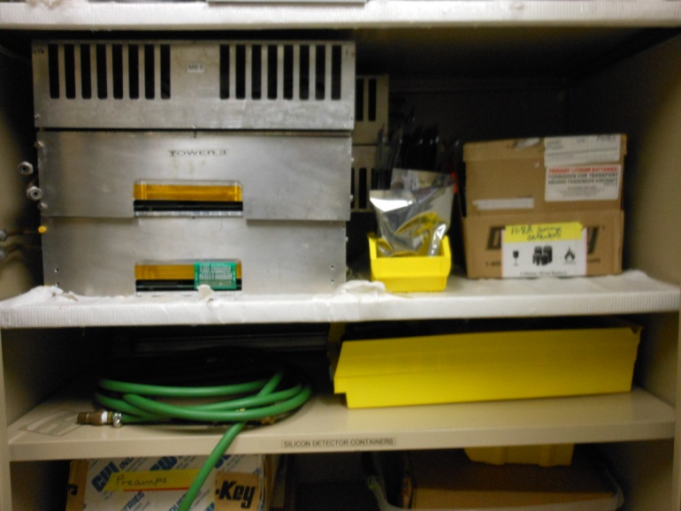
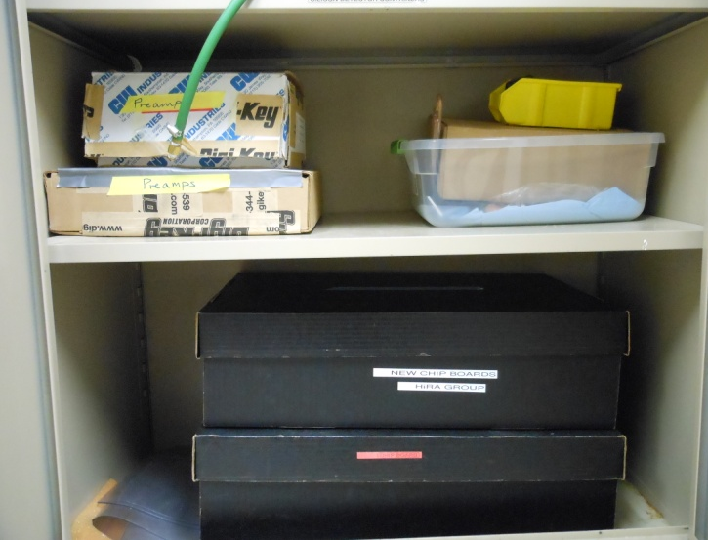
HiRA Lab Cabinet E
New ASIC MBs MCP test platform HiRA tower mount plate
Ring counter storage box HiRA extra parts
Old ASIC MBs HiRA dummy detectors few old CBs (w/o cooling bars)
Hose “to return” box
Preamps MB power converter boards Preamps LASSA parts
New chipboards Old chipboards

Slide 2
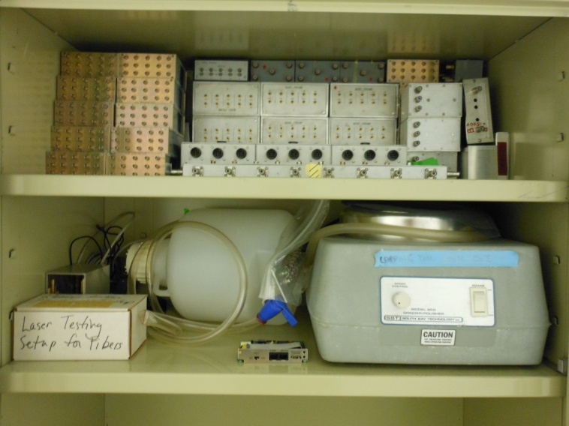
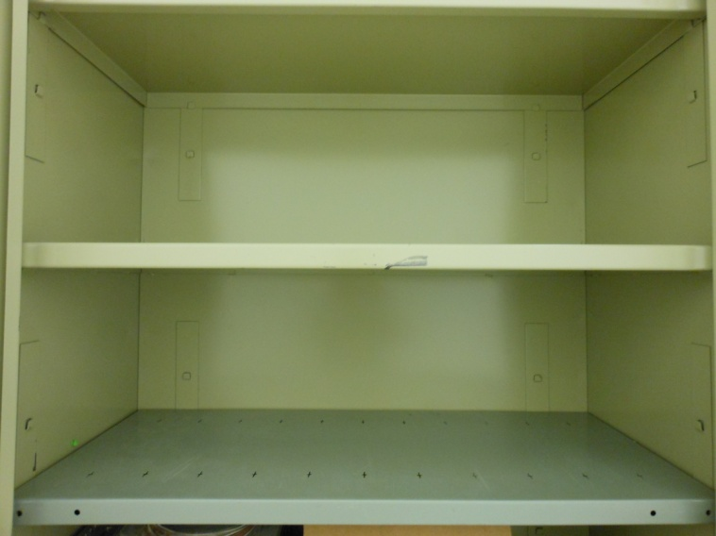
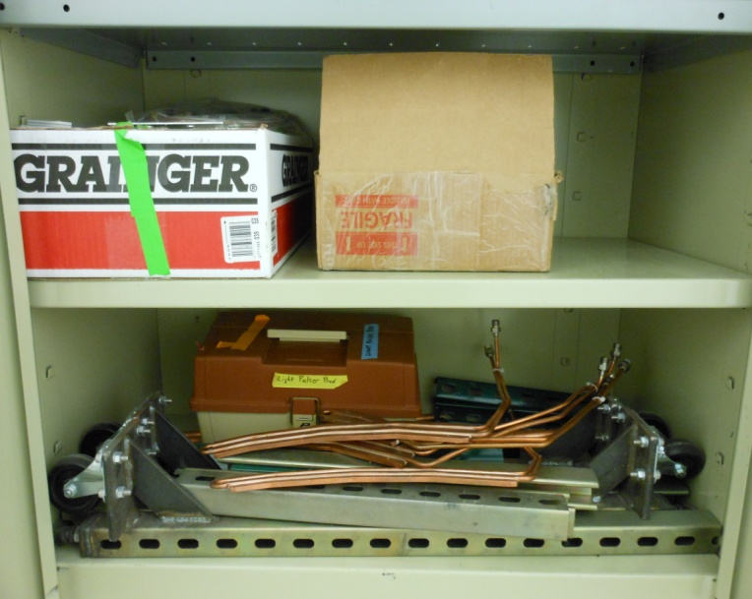
1st Floor Cabinet 111
Distribution boxes
Spare PA box Ethanol container Laser testing setup Lapping tool for CsI
Support block for alignment
Light pulser box Cooling bars

Slide 3
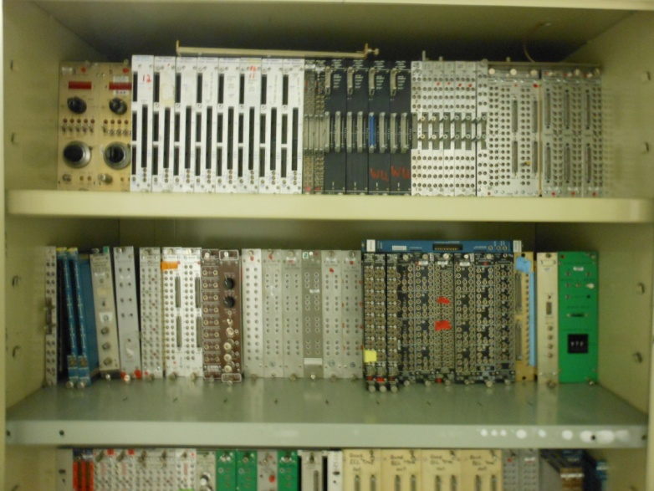
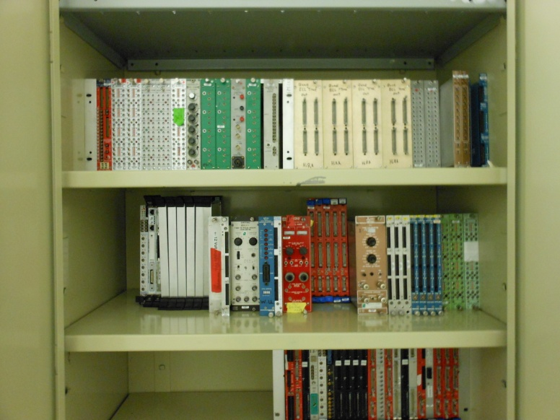
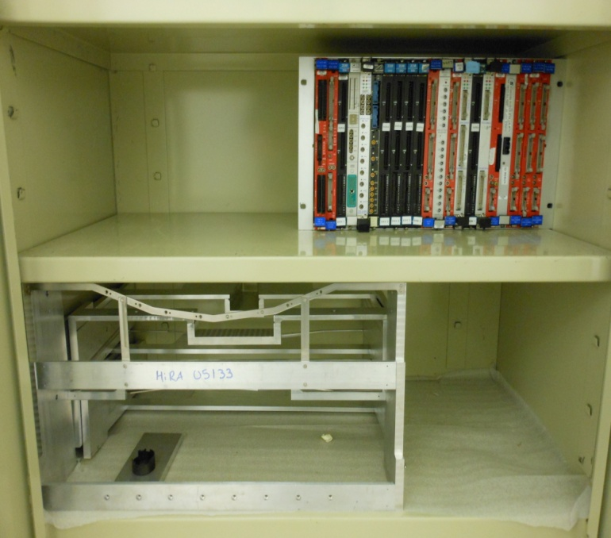
1st Floor Cabinet 112
Modules
Modules
Modules
Modules
VME Modules
HiRA mounts

Slide 4
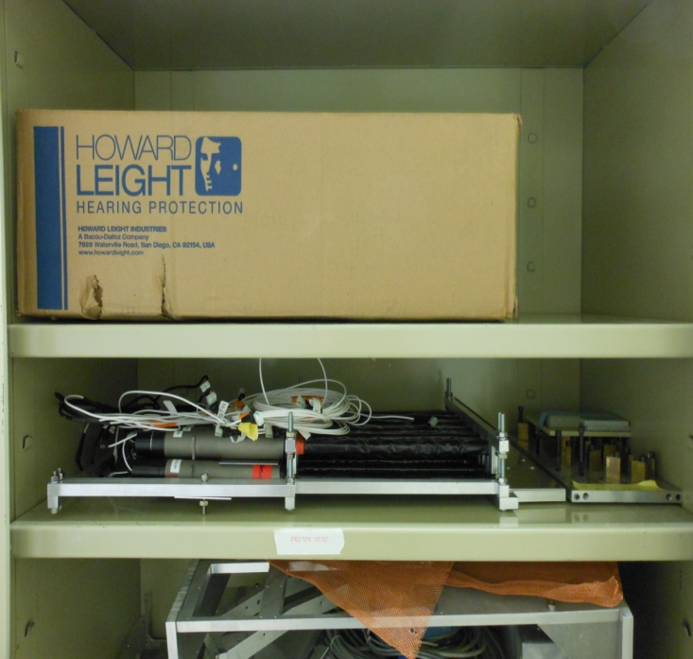
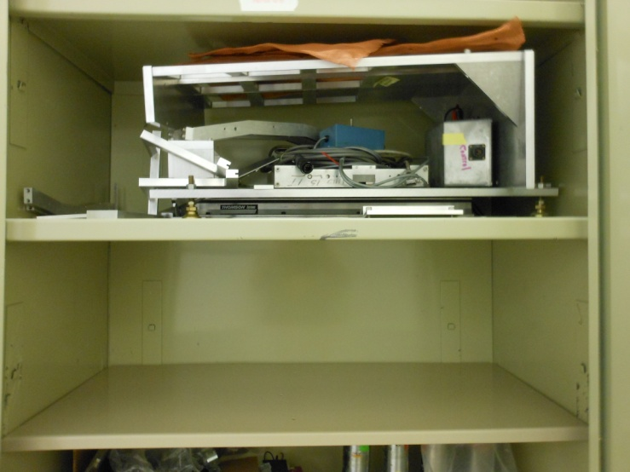
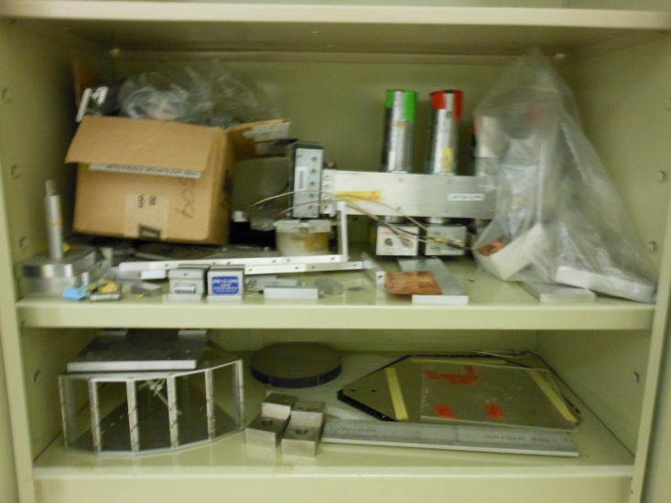
1st Floor Cabinet 113
Random parts ?
Proton Veto detector
Part of some setup ?
Forward Array
Random parts NaI(TI) mount Veto paddle mount 09042
Part of some setup ?

Slide 5
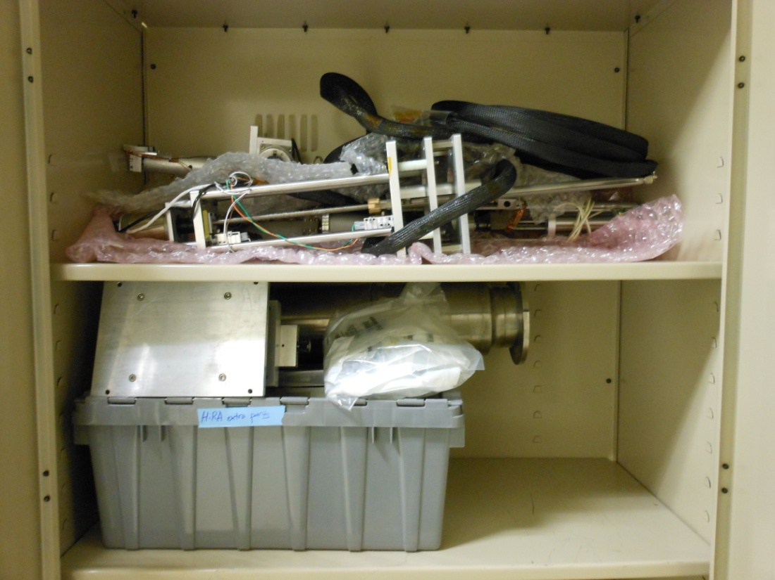
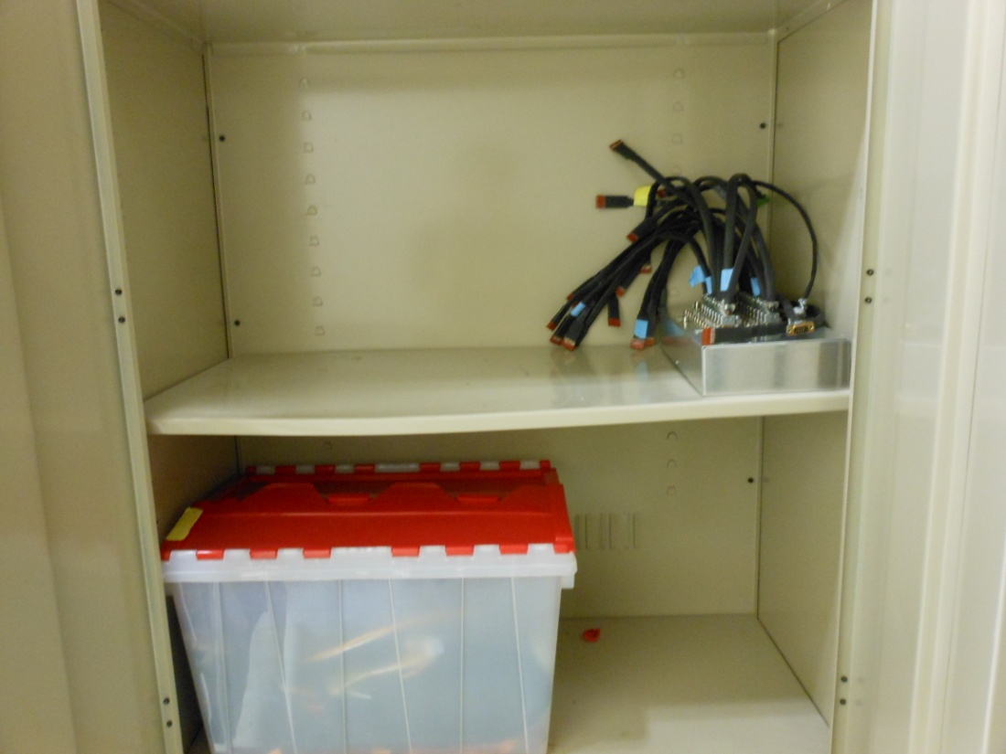
Basement Cabinet 005
Target drive
HiRA extra parts Long flange/small chamber
Meduza (PA power distribution box)
ASIC cables

Slide 6
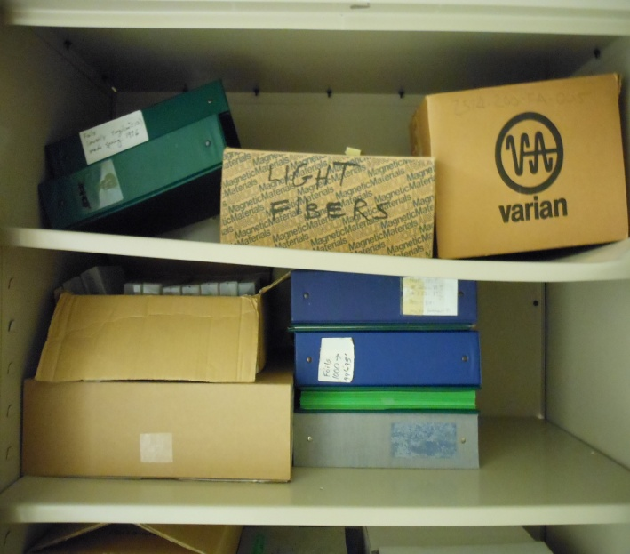
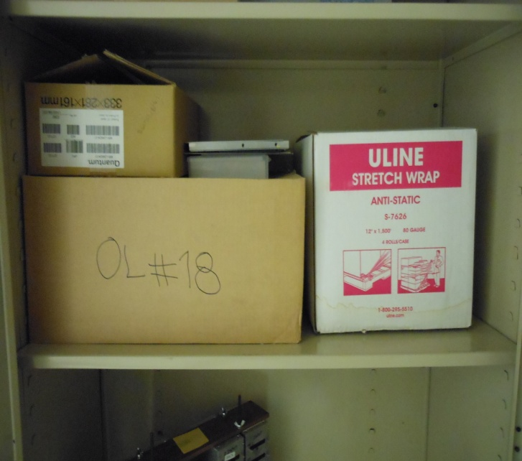
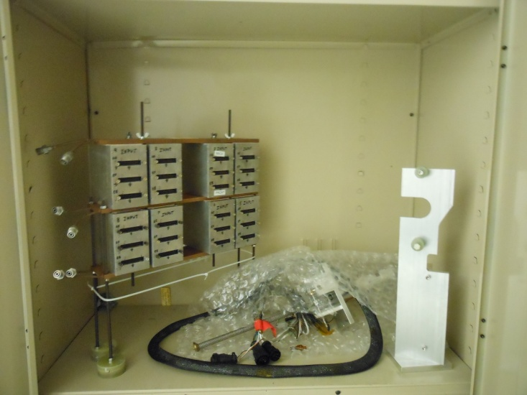
Basement Cabinet 006
Log books
Log books
? Stretch wrap
PA Boxes Target drive

Slide 7
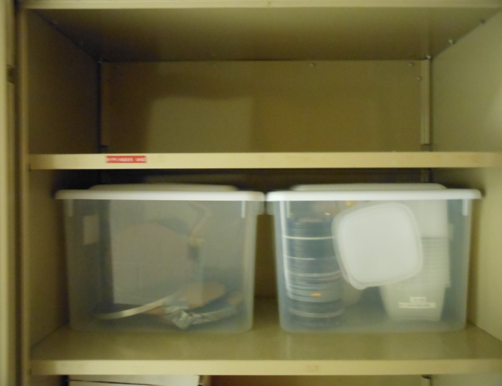
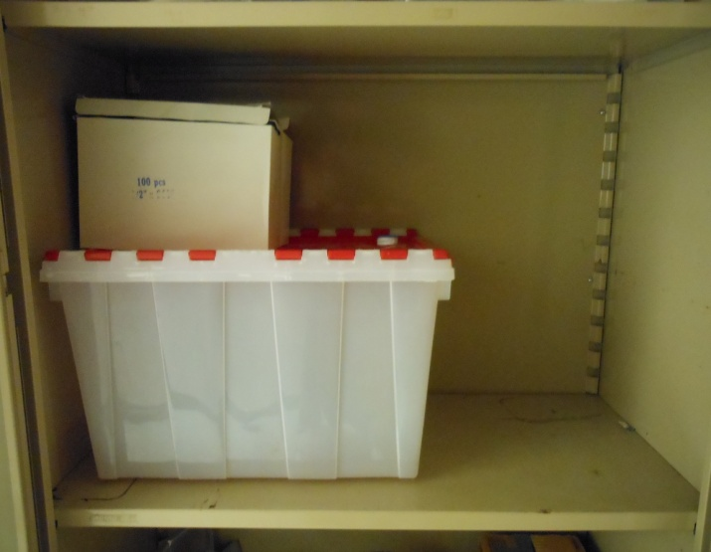
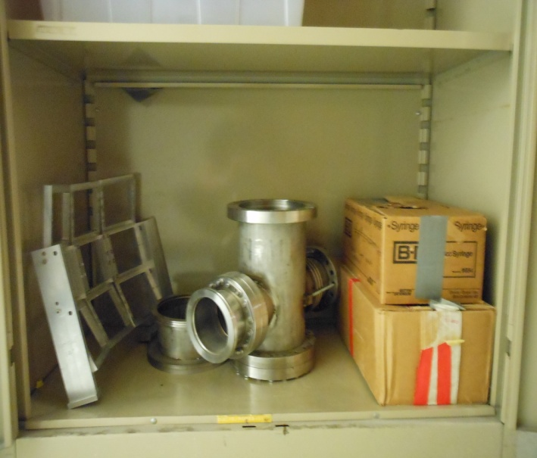
Basement Cabinet 007
Flanges Plastic boxes
Nylon tape Empty box
LASSA mount T-flange

