Slide 1
Chemical potential scaling
Scaling properties of light cluster production
What drives the particle production in heavy ion collisions?
Scaling laws observed in experimental particle ratios. Particle production driven by the chemical potential degree of freedom (isoscaling)
Dynamical models don’t generally respect ∆μ/T scaling, but this should be an important test of the models and their cluster production mechanisms.
Z. Chajecki et al, ArXiv:1402.5216, submitted to PRL

Slide 2
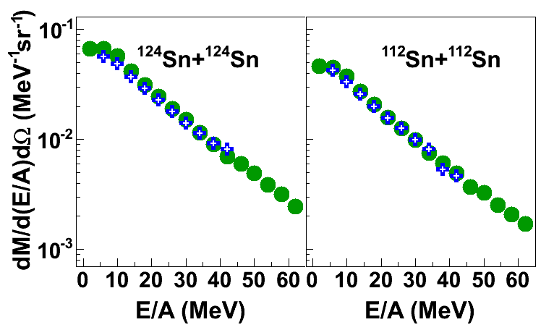
“pseudo” neutron spectra
“pseudo” neutron spectra
Consequences of using thermal interpretation of the particle ratios
neutrons
pseudo neutrons
Pseudo neutron yields
Calculating pseudo neutron spectra from charge-particle spectra introduces 10% uncertainties (within systematics of measuring neutrons)

Slide 3
Future plans
We can study the sensitivity of the neutron and proton spectral (double-)ratios to the symmetry energy and/or effective mass without a need to measure neutrons! – it’s easier to measure charged particles
Next step: study the sensitivity of n/p (double-) ratio in Ca+Ca collisions at E/A=35 and 120 MeV to the effective mass using ONLY charge particles – NSCL 14030 Experiment approved
Opens a door of opportunities to reanalyze old data in search for sensitivity to the symmetry energy or effective mass even in the absence of neutron spectra

