Slide 1
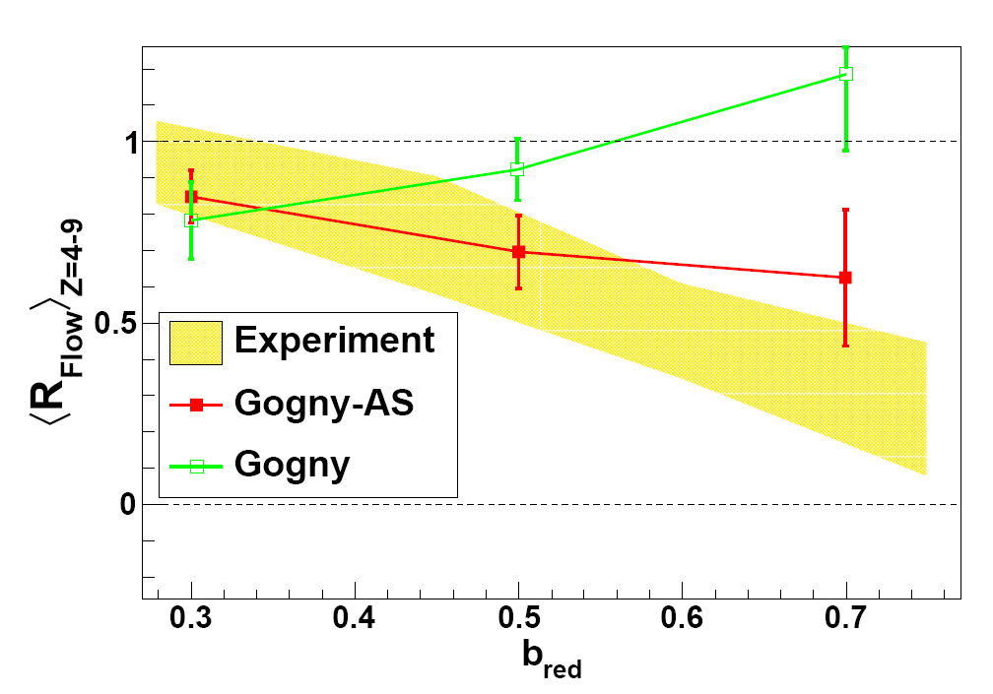
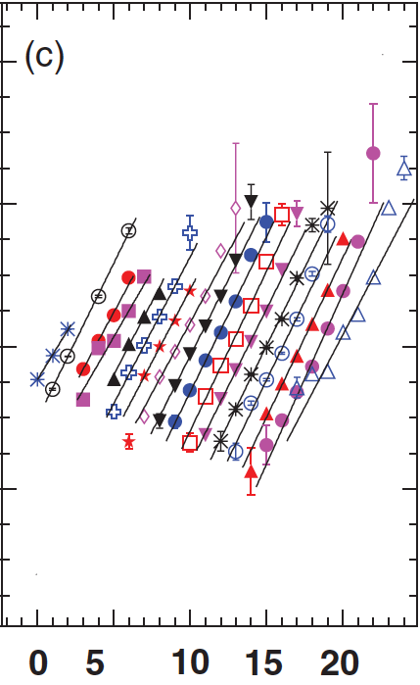
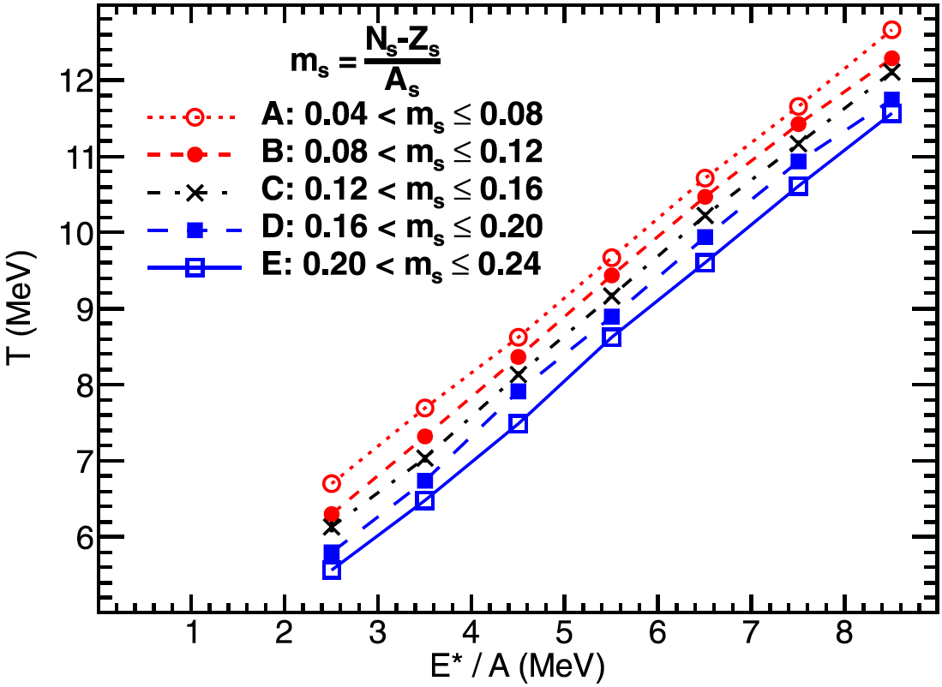
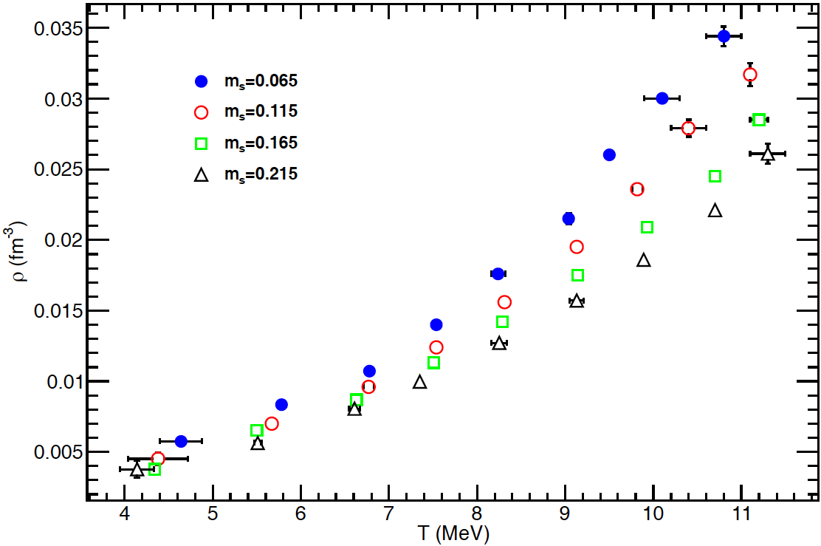
Constrain the EOS of Asymmetric Nuclear Systems
Study Heavy Ion Collisions with Multiple Probes
Motivation
Directed Flow
Isoscaling, M-scaling, Isobaric Yield Ratios
EOS relates T, ρ, P, E*/A.
N-Z asymmetry remains the largest uncertainty.
soft
ln(R₁₂)
stiff
Source reconstruction allows scaling over broadest range of isotopes (up to 8 per Z).
→ Limits set on C_{sym}
How does asymmetry affect
total energy?
temperature?
density?
pressure?
(AMD)
Directed flow (IMFs, PLFs and LCPs) is sensitive to the E_{sym}
→ Constraints on E_{sym}
N
Marini et al. Phys. Rev. C 87 024603 (2013) Marini et al. Phys. Rev. C 85 034617 (2012). Kohley et al. Phys. Rev. C 86, 044605 (2012), Phys. Rev. C 85, 064605 (2012), Phys. Rev. C 83, 044601 (2011), Phys. Conf. Ser. 312, 082030 (2011), Phys. Rev. C 82, 064601 (2010)
Asymmetry Dependence of Thermodynamic Parameters
Source reconstruction allows extraction of thermodynamic parameters for the primary excited isotopically resolved system.
→Dependence on N-Z asymmetry observed in T, ρ, P, T_{c}, ρ_{c}, and P_{c}
McIntosh et al. Eur. Phys. J. A 50, 35 (2014)
McIntosh et al. Phys. Rev. C 87, 034617 (2013)
McIntosh et al. Phys. Lett B 719, 337 (2012)
Mabiala et al. Int. J. Mod. Phys. E 22, 1350090 (2013)
Mabiala et al. Phys. Rev. C 87 017603 (2013)
Alan McIntosh, Yennello Research Group, TAMU-CI. Nuclear Physics Town Meeting, Aug 2014, College Station, TX

Slide 2
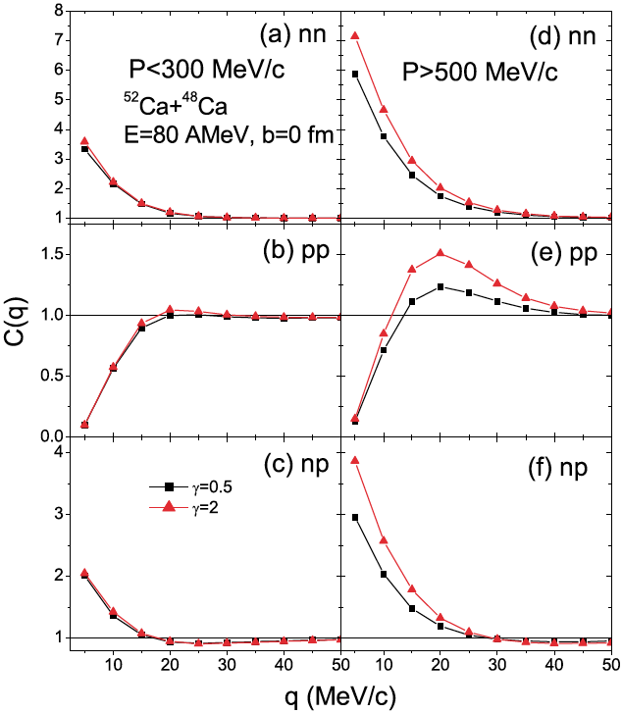
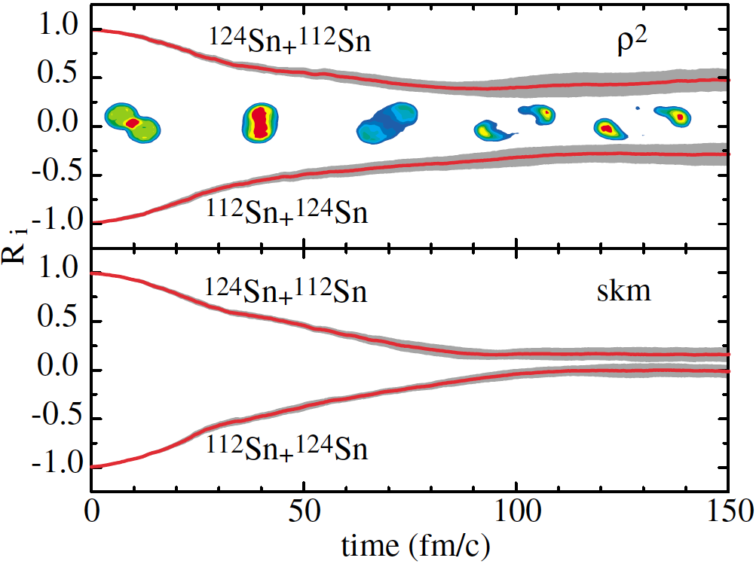
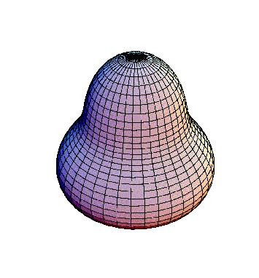
Constrain the EOS of Asymmetric Nuclear Systems
Ongoing Efforts
Isospin Diffusion
Proton-Proton Correlations
Multiple isospin transport observables in single data set.
Double cross-bombardment: ⁶⁴Ni/⁶⁴Zn/⁷⁰Zn + ⁶⁴Ni/⁶⁴Zn/⁷⁰Zn
NIMROD/ISiS array: 4π charged particles and neutrons
“Stiff” (x=-2)
“Soft” (x=1)
⁷⁰Zn+⁷⁰Zn
⁷⁰Zn+⁶⁴Zn
L.W. Chen et al, Phys. Rev. Lett. 90, 162701 (2003)
L.W. Chen et al, Phys. Rev. C 68, 014605 (2003)
⁶⁴Zn+⁶⁴Zn
iBUU simulation
Tsang et al Phys. Rev. Lett. 92, 062701 (2004)
Nuclear Shape Deformation
¹²⁴Xe + ⁵⁸Ni and ¹³⁶Xe,¹²⁴Sn+⁶⁴Ni @ 15 MeV/u
FAUST + QTS spectrometer
Deformation (quad, oct) predicted sensitive to E_{sym}
Sliced Inverse Regression may improve sensitivity
Predicted sensitivity to E_{sym}
40Ca + 58,64Ni @ 45 MeV/u
FAUST array: Si/CsI
Position to <200um → precision correlations
P. Cammarata et al., NIMA 761, 1 (2014)
SMF simulation
M. DiToro, et al. Nucl.Phys.A 787, 585 (2007)
M. Colonna, Workshop on Simulations of Low and Intermediate Energy Heavy Ion Collisions, 2009.
image credit: http://physics.stackexchange.com
Alan McIntosh, Yennello Research Group, TAMU-CI. Nuclear Physics Town Meeting, Aug 2014, College Station, TX

Slide 3
Constrain the EOS of Asymmetric Nuclear Systems
Future Aims and Challenges
Asymmetry dependence of temperatures, densities: verify and quantify
Low to intermediate energy N-Z asymmetric beams (15-35 MeV/u)
Residue spectrometer – QTS, MDM, MARS at TAMU
Charged particle detector – FAUST, NIMROD
Extend measurements to more exotic asymmetry
Observables of interest
Directed flow
Isoscaling of the heavy residues
Isospin transport observables
Deformation of PLF
Needs:
Fermi-energy N-Z asymmetric beams (~35 MeV/u)
Large acceptance charged particle & neutron array with isotopic resolution
NIMROD, FAUST at TAMU
Couple to spectrometer – MARS, MDM at TAMU
Alan McIntosh, Yennello Research Group, TAMU-CI. Nuclear Physics Town Meeting, Aug 2014, College Station, TX

