Slide 1
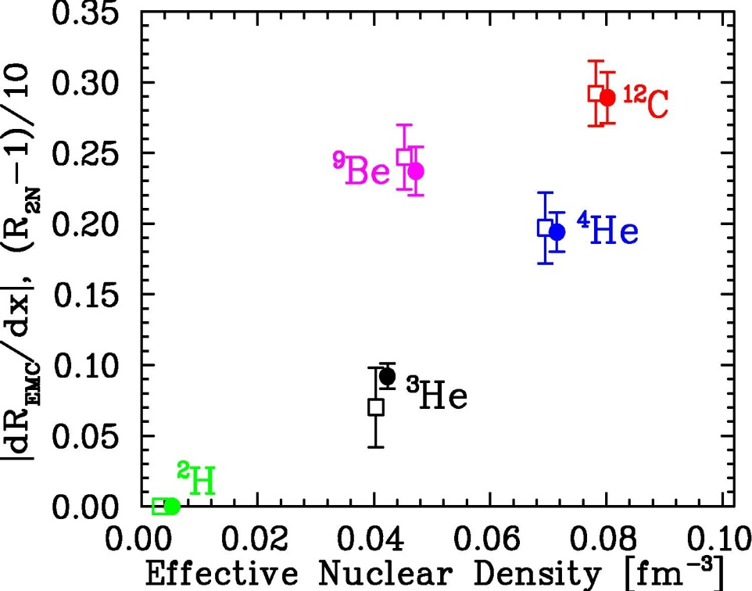
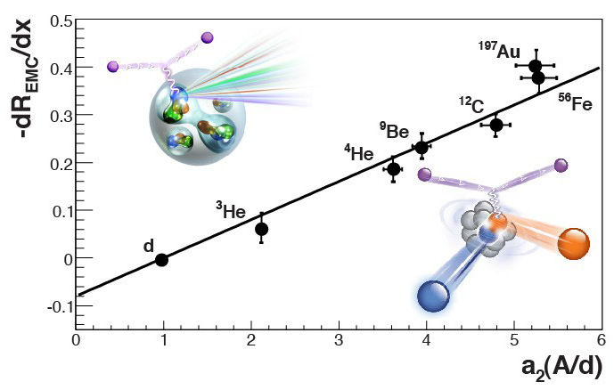
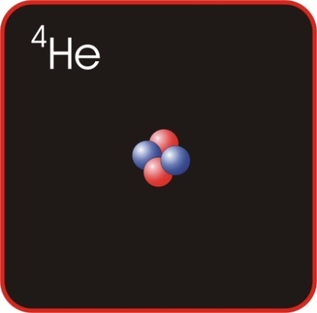
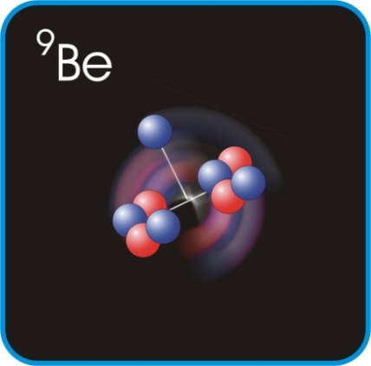
JLab6: Cluster structure connects to high-momentum components and internal quark modification of nuclei
Short-Range Correlations (SRCs) dominated by np pairs interacting via tensor force
EMC effect: 10% suppression of high-x quarks in all nucleons or 50% effect in the 20% in SRCs?
Relevant for high-density nuclear matter
J. Seely, et al., PRL103, 202301 (2009)
N. Fomin, et al., PRL 108, 092052 (2012)
J. Arrington, et al., PRC 86, 065204 (2012)
L. Weinstein, et al., PRL 106, 052301 (2011)
O. Hen, et al, PRC 85, 047301 (2012)

Slide 2
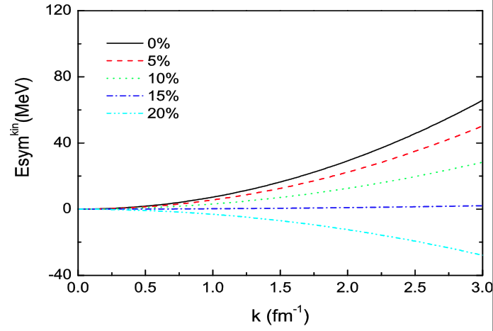
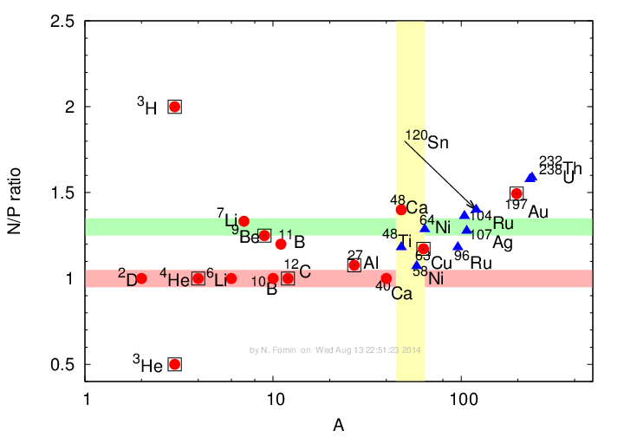
JLab6,12: Mass, Isospin-dependence of SRCs
Impact of np-dominated SRCs (based on present data)
Future measurements:
Better quantify n-p dominance
Light nuclei (cluster structure)
Separate mass, isospin dependence
Effect of np-SRC on the kinetic part of the symmetry energy
0%
E_{sym}^{kin} [MeV]
³H
³He
¹H
²H
³He
⁴He
^{6,7}Li
⁹Be
^{10,11}B
¹²C
⁴⁰Ca
⁴⁸Ca
Cu
Au
15%
20%
2
k_{F} (fm⁻¹)
MSU
Sn+Sn data
np-SRC
Preliminary
No
Correlations
n/p double ratio from Sn-Sn collisions

Slide 3
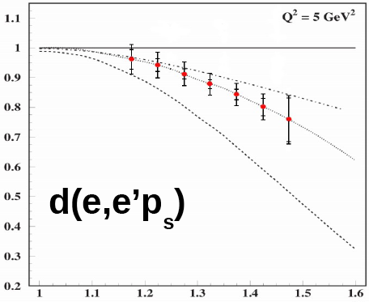
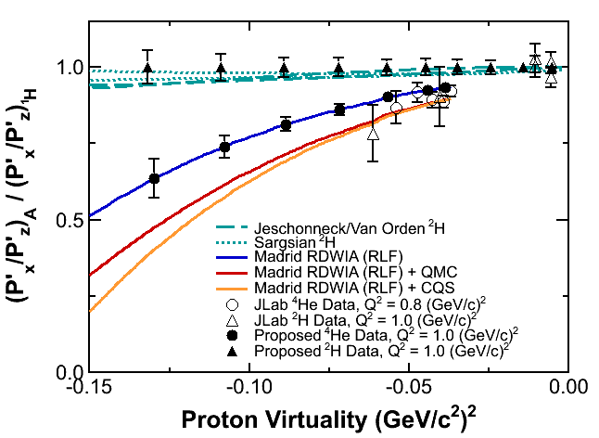
JLab12: Probing Internal Quark Structure of SRCs
1) DIS from high-momentum nucleon
2) e-p elastic from high-momentum proton
?
Proton light-cone momentum
3) Quark distributions of deuteron at x>1
q_{D}(x)
two-nucleon only
two-nucleon only
5% 6 quark bag
5% 6 quark bag
4) “Spin” EMC effect in polarized ⁷Li – Test modern microscopic models of EMC effect
100+% effect in SRC-dominated region
~1% “EMC effect”

