Slide 1
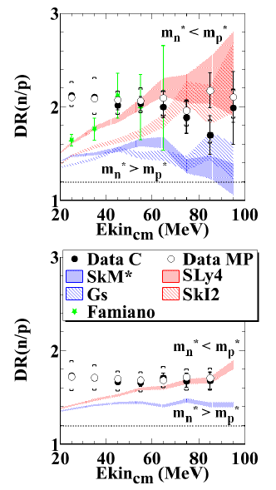
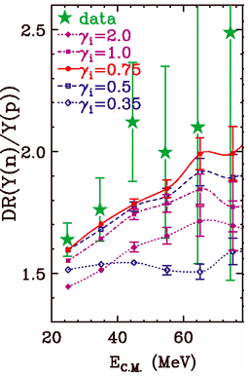
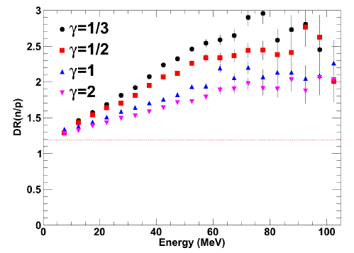
Effective Nucleon Masses in Compressed and Expanding Neutron-Rich Matter: Motivation
Multiple simulations suggest sensitivity of the n/p single and double ratios to both the nucleon effective mass and symmetry energy
Previously, an experiment measured these at one beam energy (50 MeV/A).
Re-measure and add additional beam energy (120 MeV/A)
Symmetric 112,124Sn reactions
Data is cut on central collisions and 70<θ_{C.M.}<110
ImQMD: Tsang, PRL 102, 122701 (2009)
ImQMD-Sky: Coupland, Ph.D. Thesis (2013)
pBUU: Youngs, Ph.D. Thesis (2013)
Mike Youngs, Texas A&M University (presenting work from Michigan State University), Low Energy Community Meeting, August 2014

Slide 2
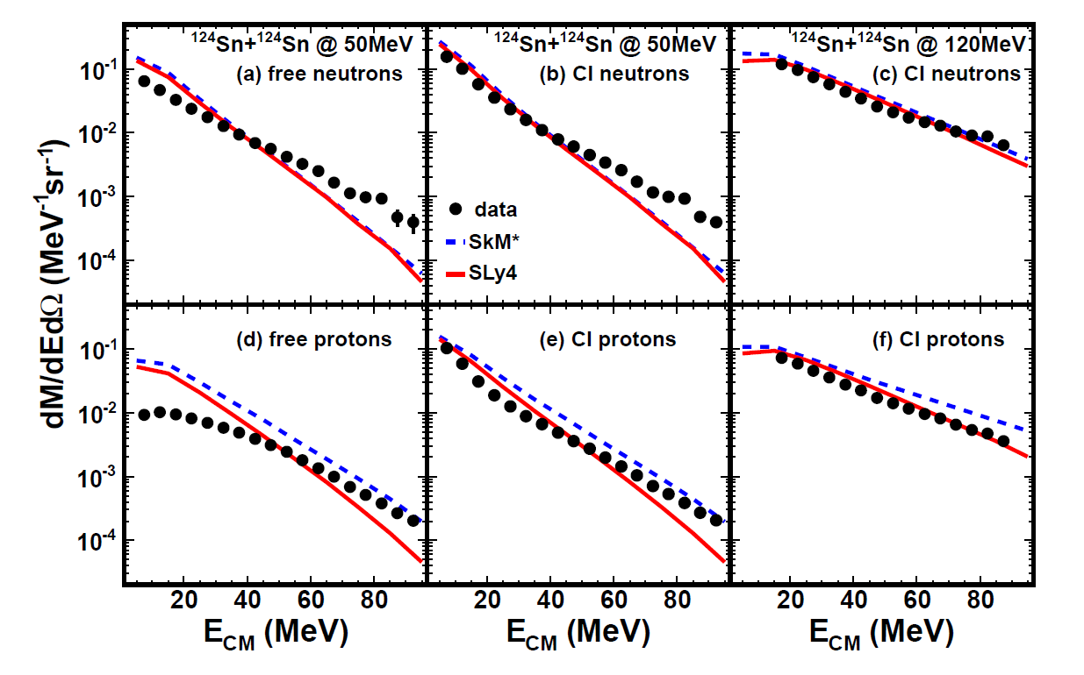
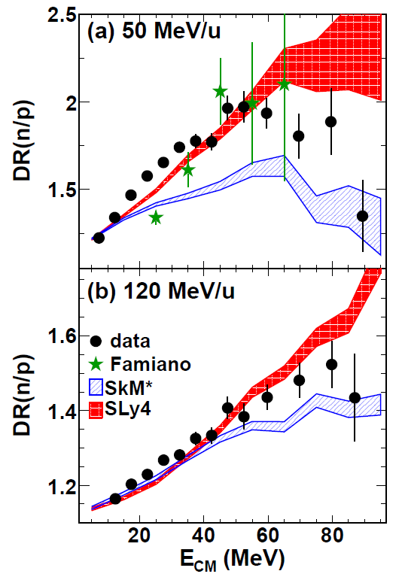
Results
CI = Coalescence Invariant
Coupland (2014) Submitted to Science
Mike Youngs, Texas A&M University (presenting work from Michigan State University), Low Energy Community Meeting, August 2014

Slide 3
Looking Forward/What’s Needed
Better understanding of the discrepancies between simulated and experimental data at low emission energy.
A wider collection of neutron kinetic energy spectra
Varying beam energy, mass and asymmetry
NEED a good understanding of background and detection efficiency
Bonus: potentially useful for a better understanding of clustering mechanisms
Potentially useful datasets of neutron spectra:
Symmetric 40,48Ca
Symmetric 64,70Zn
132Sn+124Sn, 108Sn+112Sn
Useful beam energies:
15-30 MeV/A for low density regimes (subsaturation)
50 and 120 MeV/A for comparison to existing measurements
200 MeV/A or higher for higher density regimes (supersaturation)
Large range of other observables can be measured simultaneously
Mike Youngs, Texas A&M University (presenting work from Michigan State University), Low Energy Community Meeting, August 2014

